Slide 1
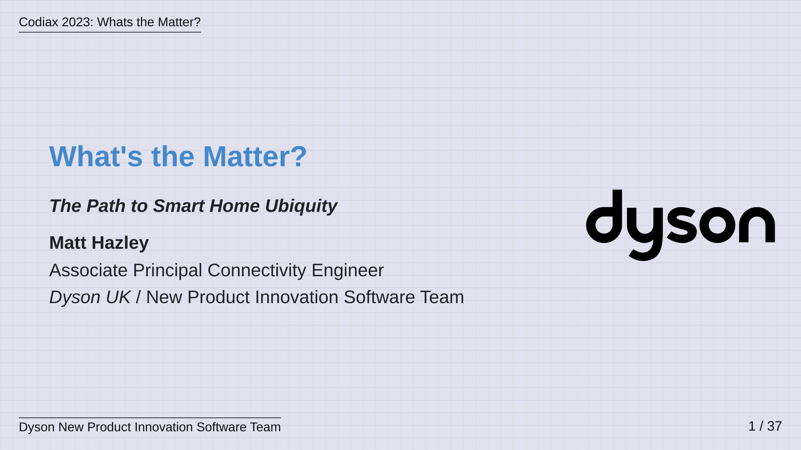
Notes:
Hi everyone, my name is Matt Hazley, I am an Associate Principal Embedded Connectivity Engineer in Dyson's New Product Innovation Software Team. I'd like to thank you all for coming to listen to my talk today, which is entitled "Whats the Matter", The Path To Smart Home Ubiquity. My aim today is to talk to you about the state of the Smart Home and to discuss the path towards ubiquity for both Product Manufacturers and Smart Home Platforms alike, via the Matter Standard. I'll also take some time to talk about what its been like to work on this standard and to try and deliver it into Dyson.

Slide 2
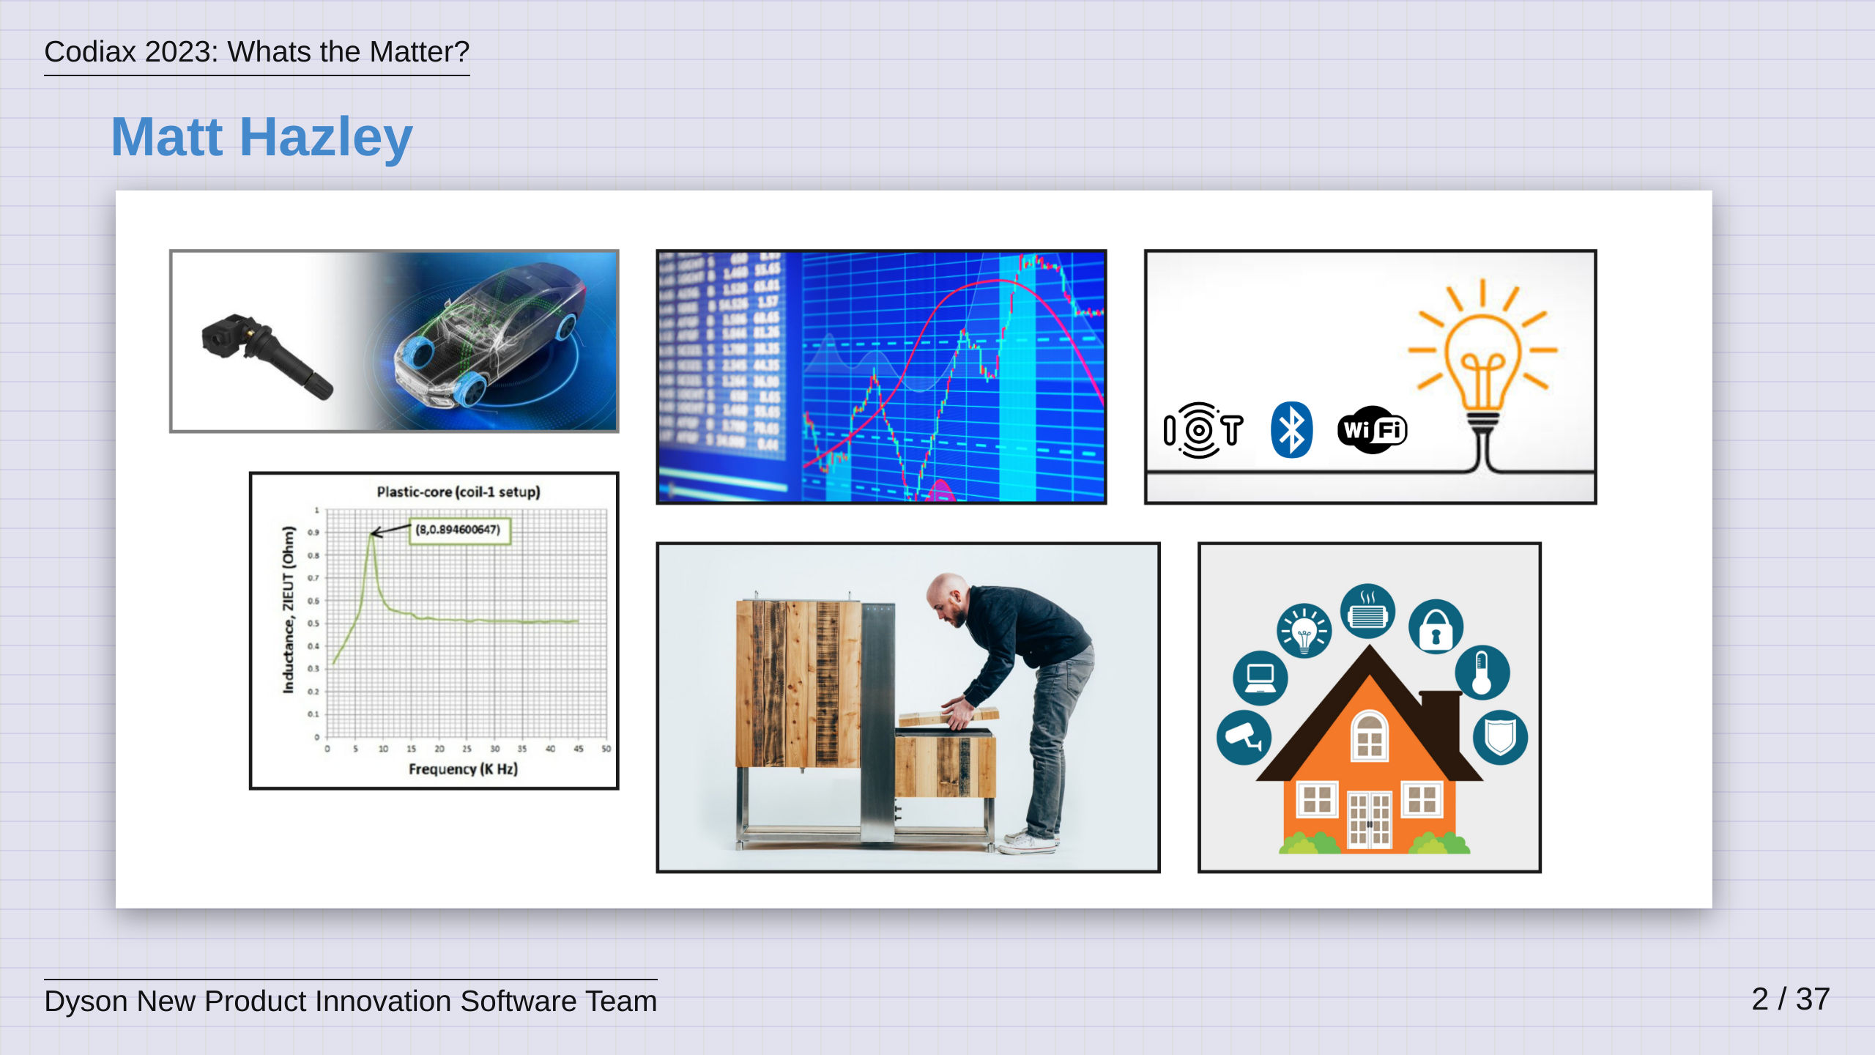
Notes:
So, who am I and how have I ended up here today. I started my career just over 14 years ago and for the first 7 years I worked on low level automotive sensor firmware, represented here by the left-most pictures - we worked on low power tyre pressure sensing and we also looked at RF based tank level sensing for things like fuel and adblue. I did have a brief stint working on high throughput middlewares for stock exchange feed-handlers but if I am honest, I really missed working on embedded products so I quickly escaped! In 2016, I became the Firmware Lead at a startup called Brewbot, seen here bottom middle. We were developing an automated, home-brewing machine and I think it was probably the most fun I have ever had but at the same time, also the most stress! This company ultimately ran out of money but it did awaken my love for all things IoT so following this, I moved to work in Dyson and was an early employee into a new team there that was focusing on IoT prototyping and pushing connected innovation into the company's roadmap. It was here that I got involved with Smart Home technologies and this is the focus of my work today.

Slide 3
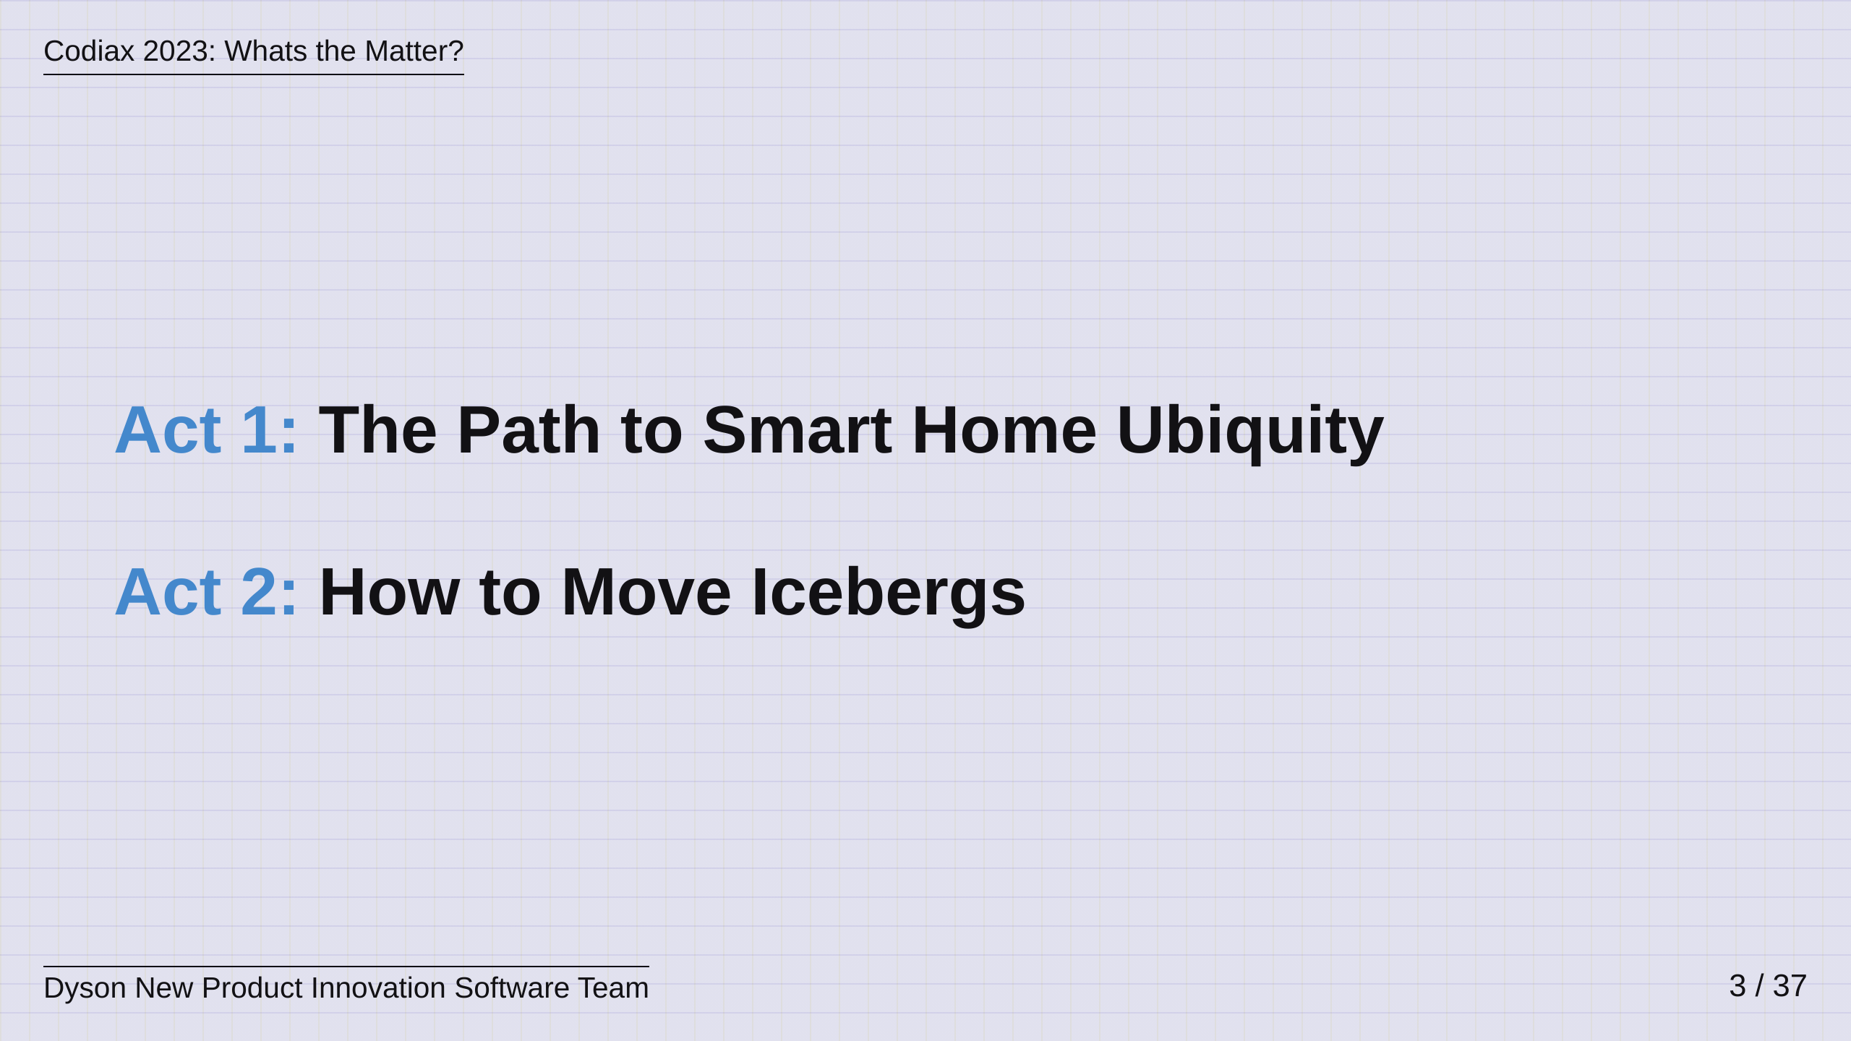
Notes:
So... I've broken this talk into two acts, one trechnical in nature, and the other a little more fun and philosophical, which we'll get to later.

Slide 4
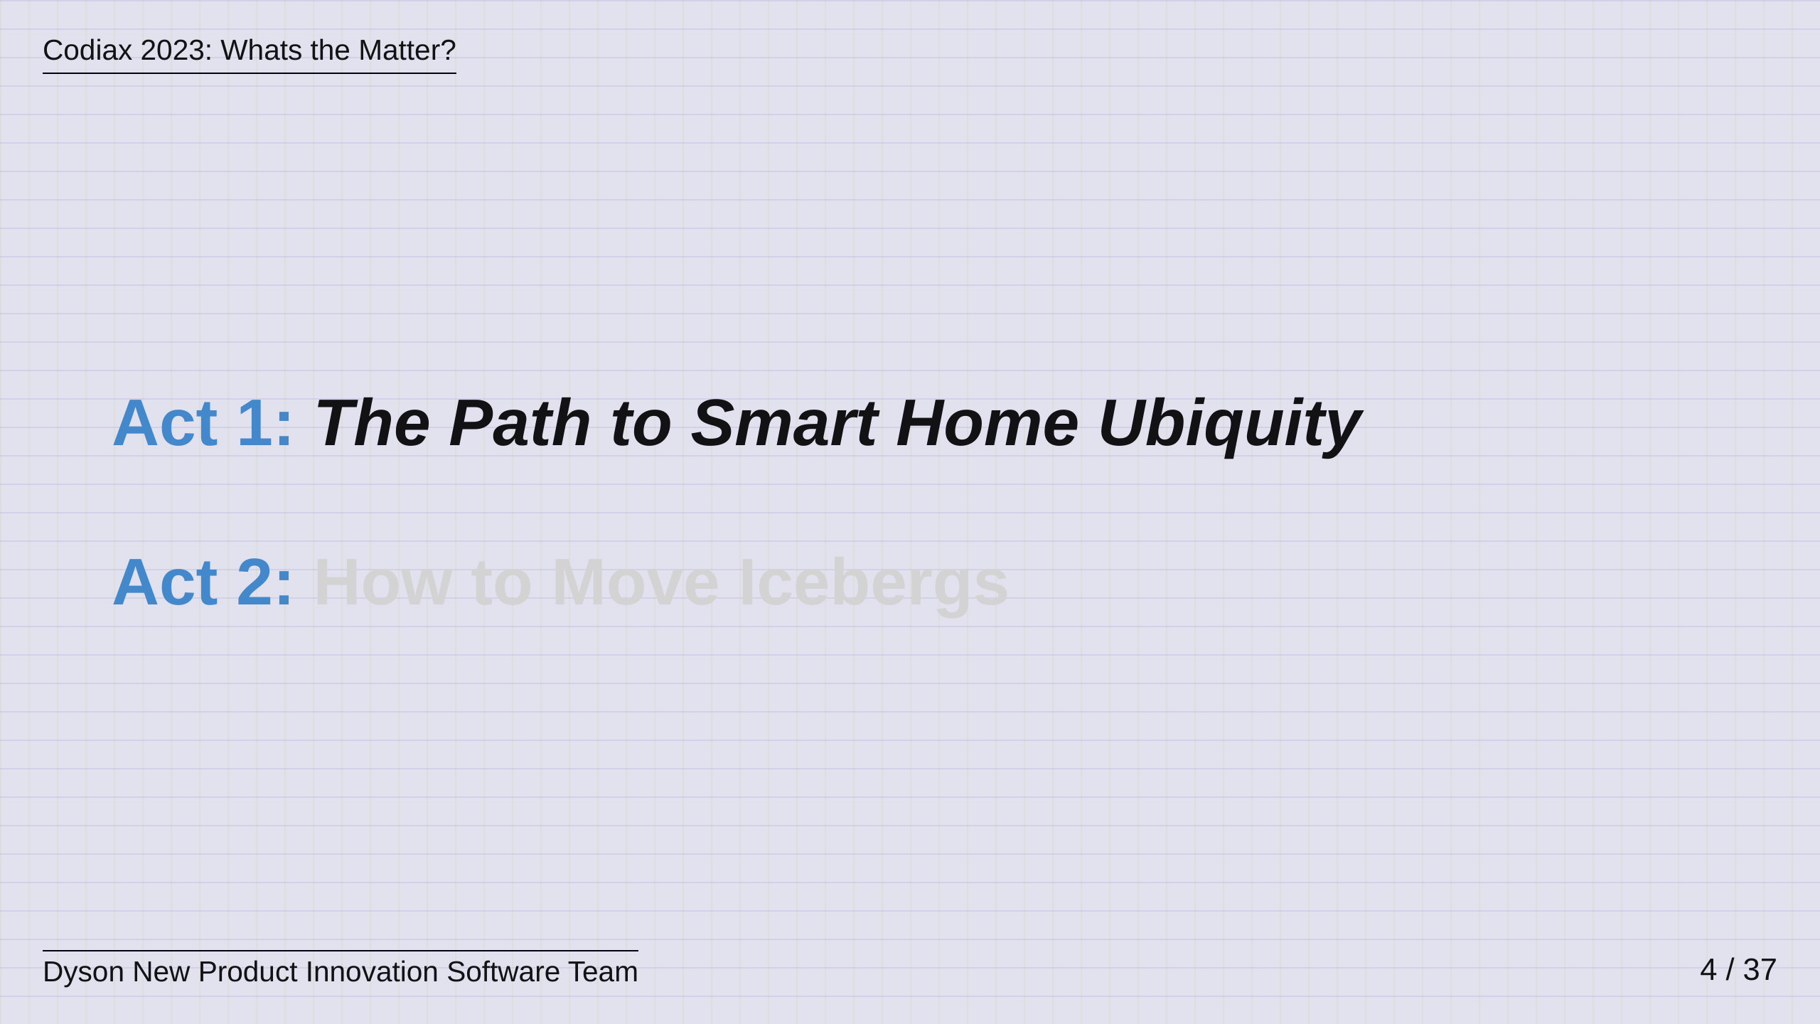
Notes:
Act One though, The Path to Smart Home Ubiquity....

Slide 5
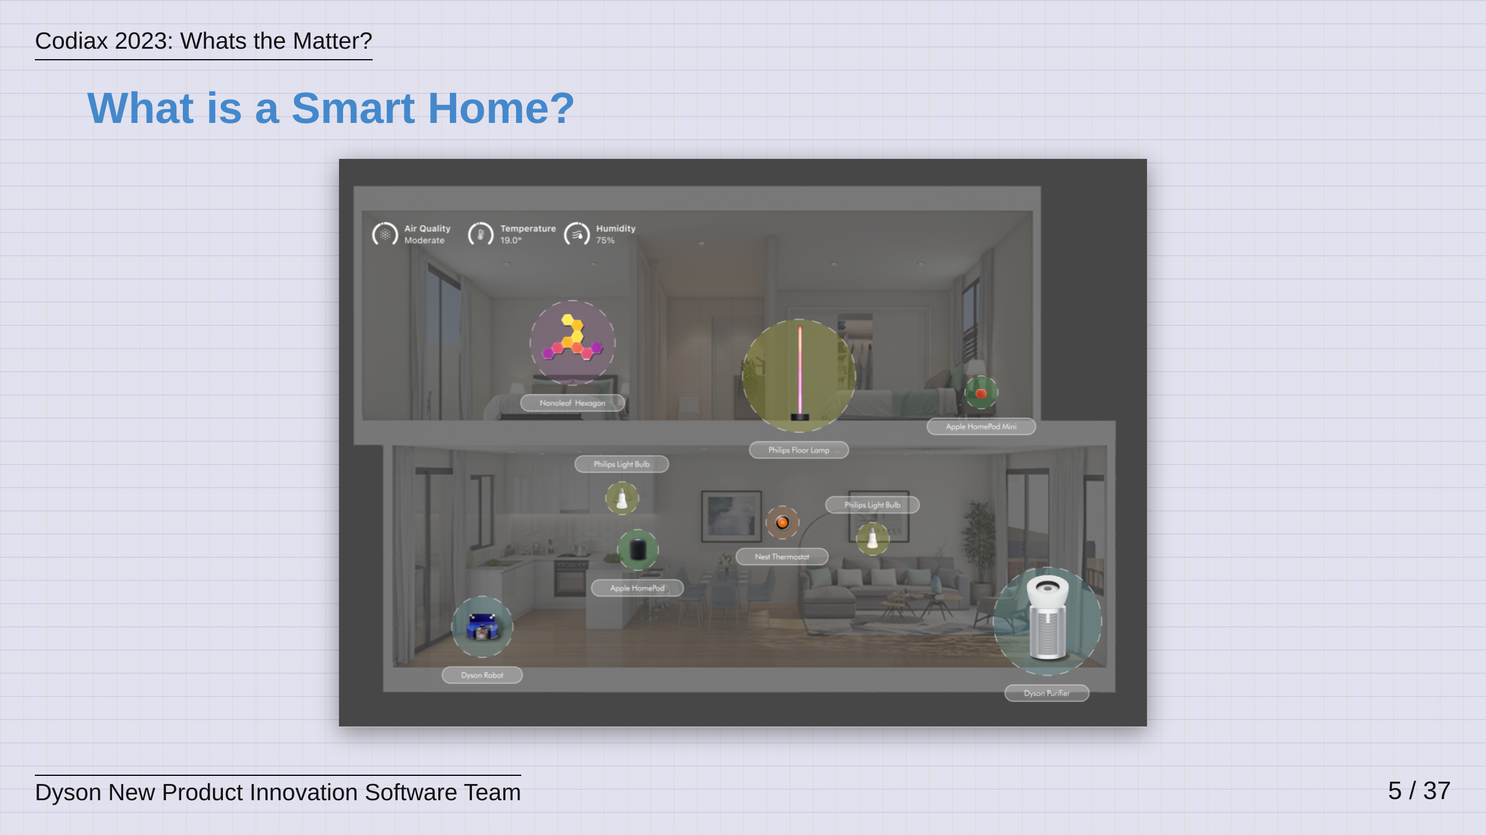
Notes:
What is a Smart Home? At Dyson, we believe a single connected product does not make a Smart Home. A Smart Home is a combination of products working together to unlock value and features that are greater than the sum of its parts. We believe the Smart Home Network increases in value as more devices are added and if different manufacturer products can work together.

Slide 6
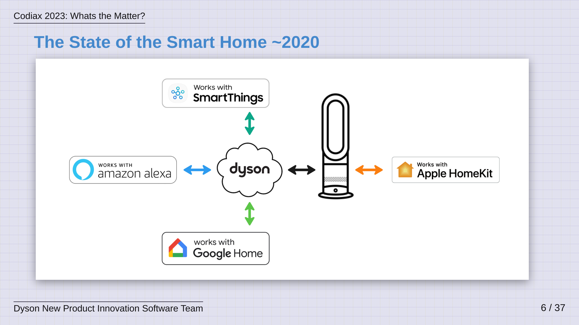
Notes:
So, around the turn of the decade we found ourselves in a situation like you see here. Each existing Smart Home platform had its own protocols and configuration. It​ required comapnies to commit to technical development and significant support to ‘on-board’ & support a new platform with their connected product. In the diagram, consider that each arrow is a completely different integration and protocol. Also consider that some of the integrations are cloud to cloud, whereas some are integrated with the device. This not only makes it difficult for device manufacturers but it also leads to a Poor User Experience and Lower Consumer Choice as the user has to start seeking out what products work with their platform of choice. This fragmented set of platforms was untenable and to a degree, this still exists today. It has to change.

Slide 7
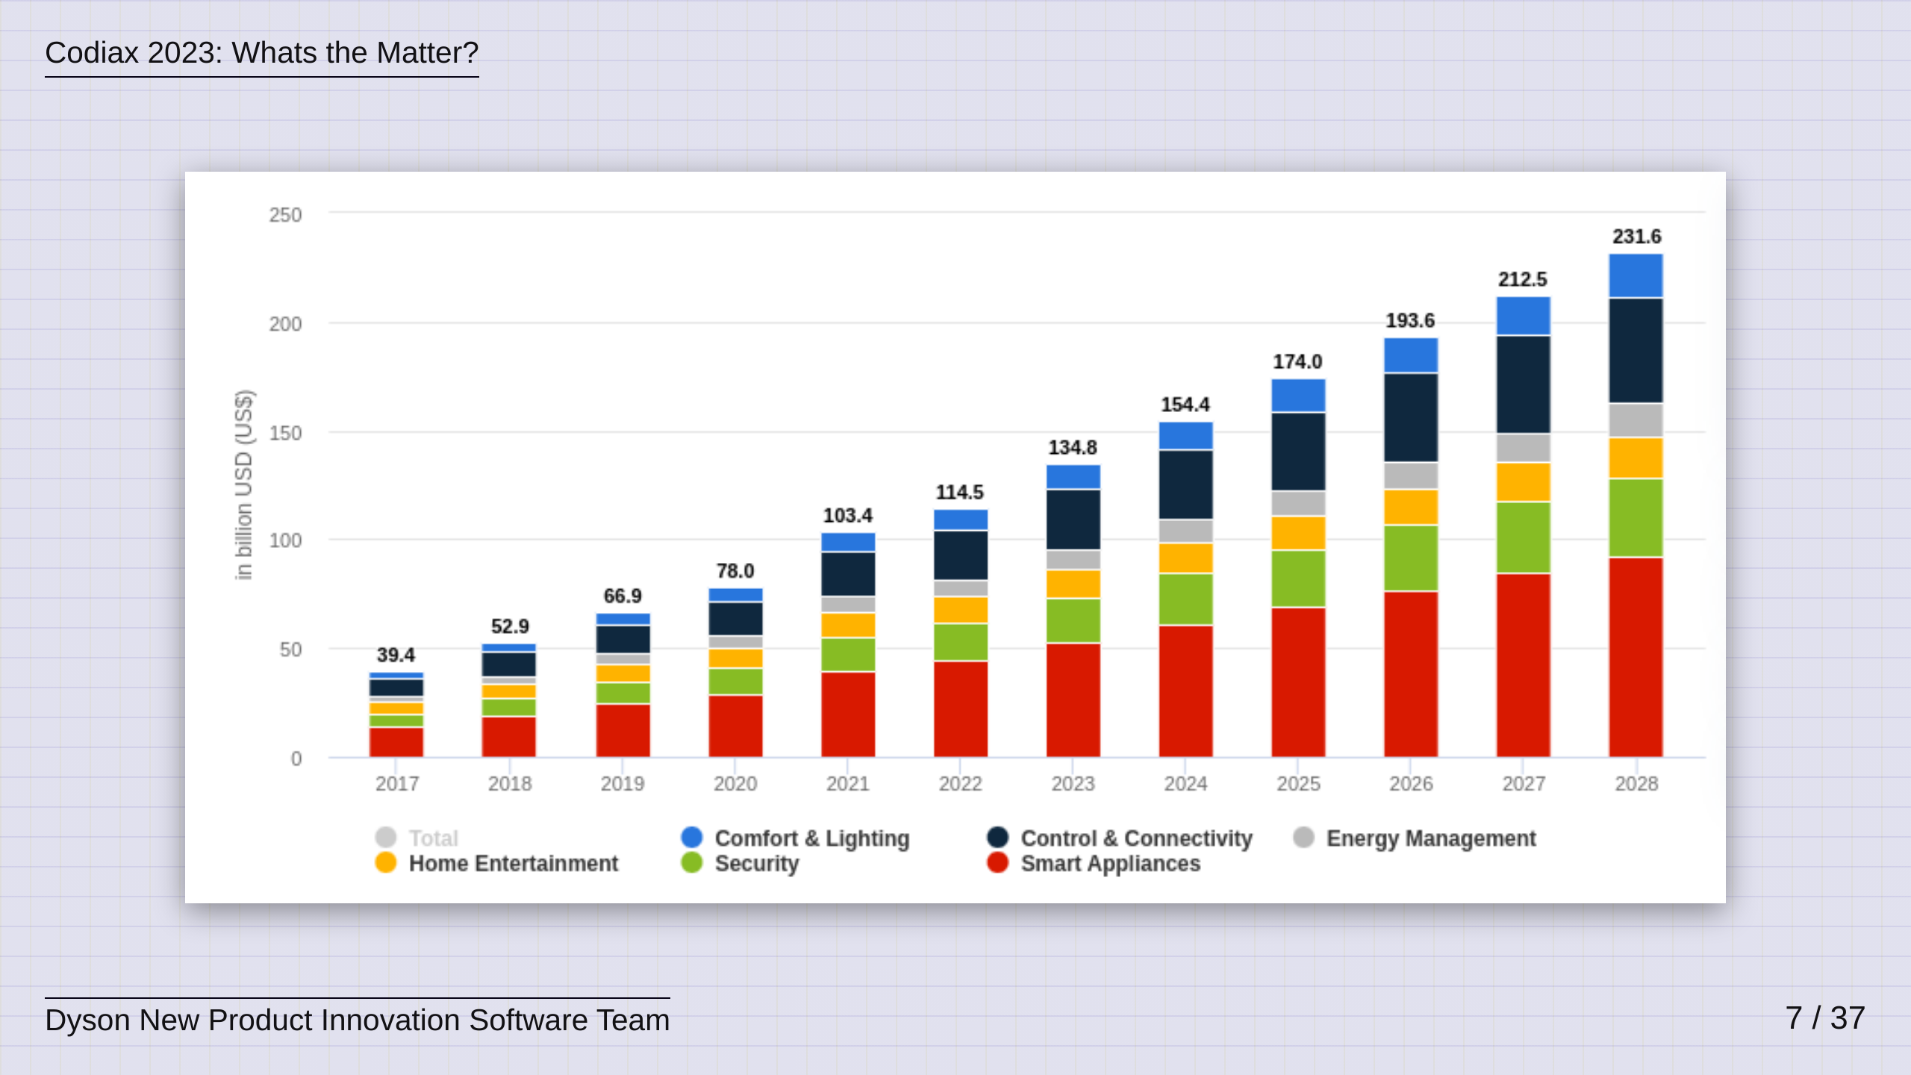
Notes:
It has to change because Market Research shows that the Smart Home market is set to have almost doubled by the time we reach 2028. Here, the Statista 2023 Market Research Report on Smart Home shows that Household penetration was around 14% in 2022 and is predicted to be 33% by 2028 with a signifcant rise in Smart Appliances and Connectivity. This means we need to start to think about a ubiquitous soluition to this problem.

Slide 8
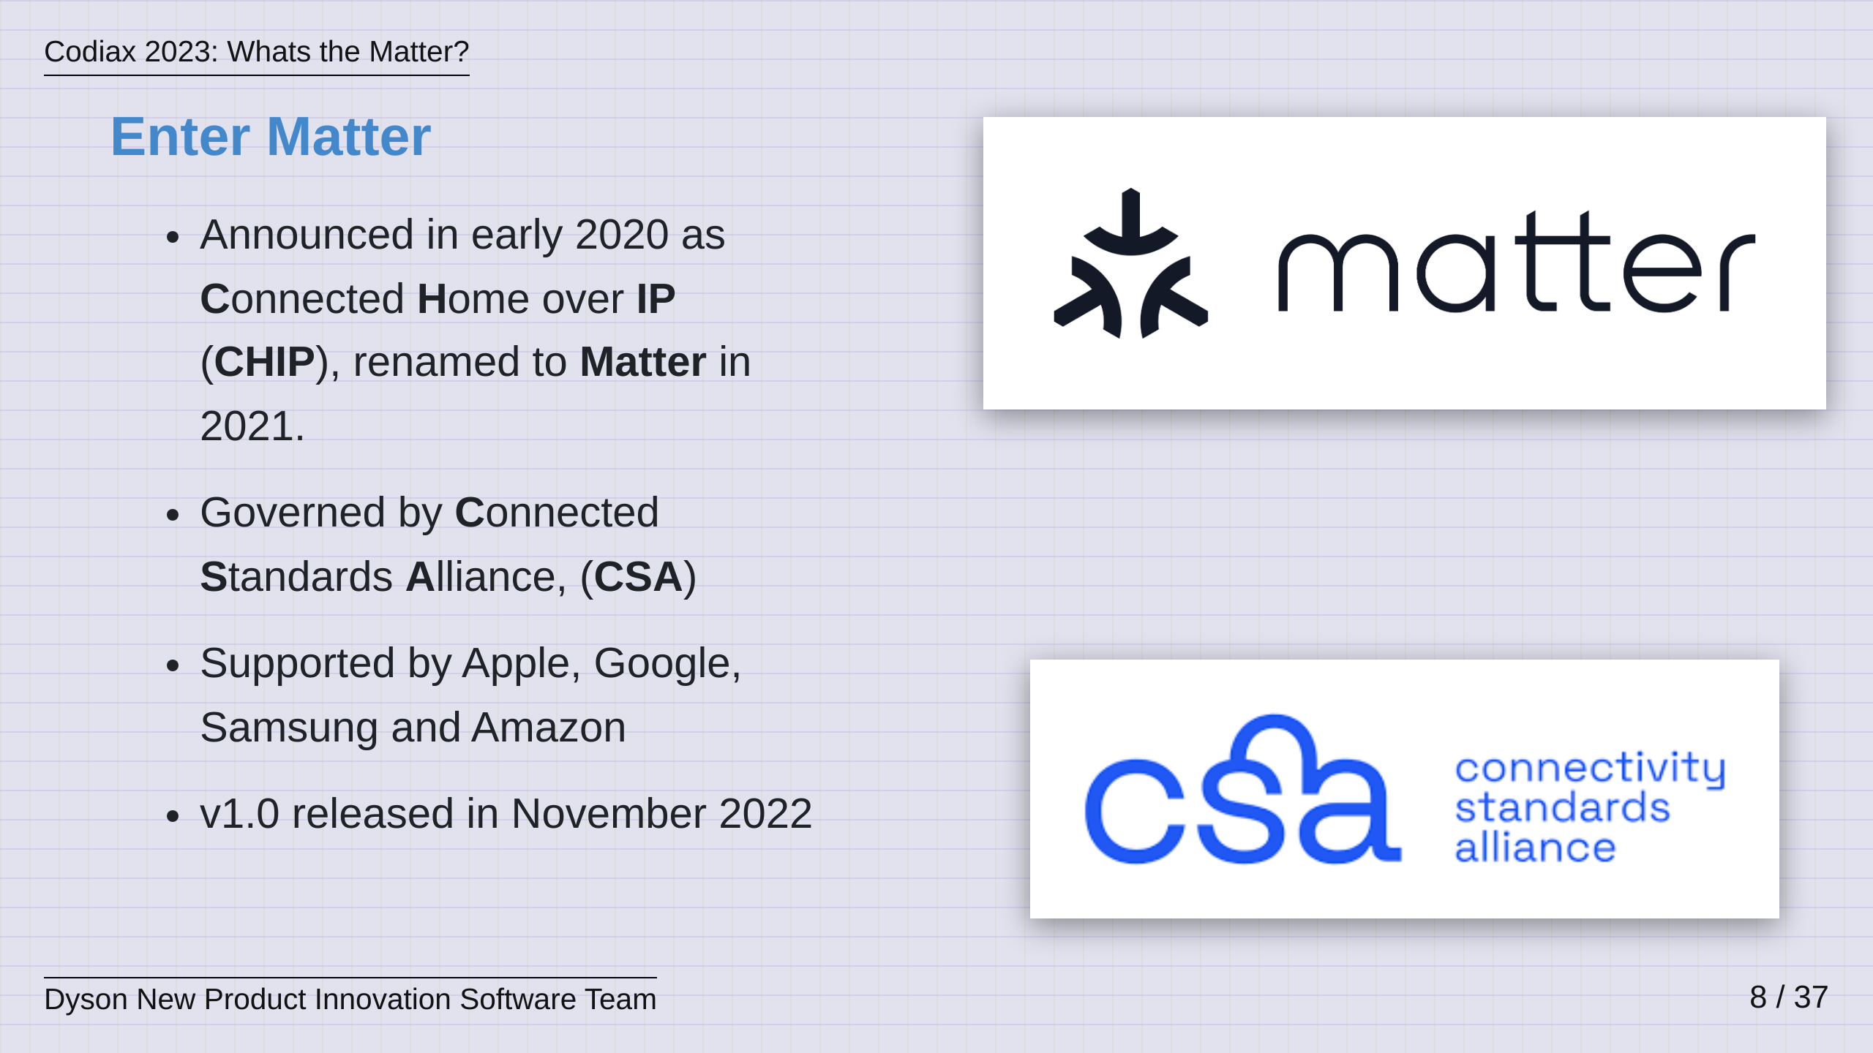
Notes:
Enter Matter! Matter was announced in early 2020 and it claimed that it would create an open source codebase that would bring forward “a unifying standard for the smart home industry”​. Apple, Amazon, Google & Samsung all formally announced their support at the inception of the project and this support has only grown in the past few years, with around 50 companies showcasing Matter on their products at CES this past year. The project is goverened by the Connectivity Standards Alliance who were formerly the Zigbee Alliance and this is a consortium of almost 500 companies who came together over the last 20 years to develop Zigbee, and are now driving Matter. v1.0 of Matter launched just over one year ago in Nov 2022 and it maintains a twice yearly release cycle with 1.2 having just dropped a few weeks ago. The goal of Matter is to allow any device supporting Matter to interact with any Smart Home Ecosystem that understands Matter​. So lets take a look at how it all works.

Slide 9
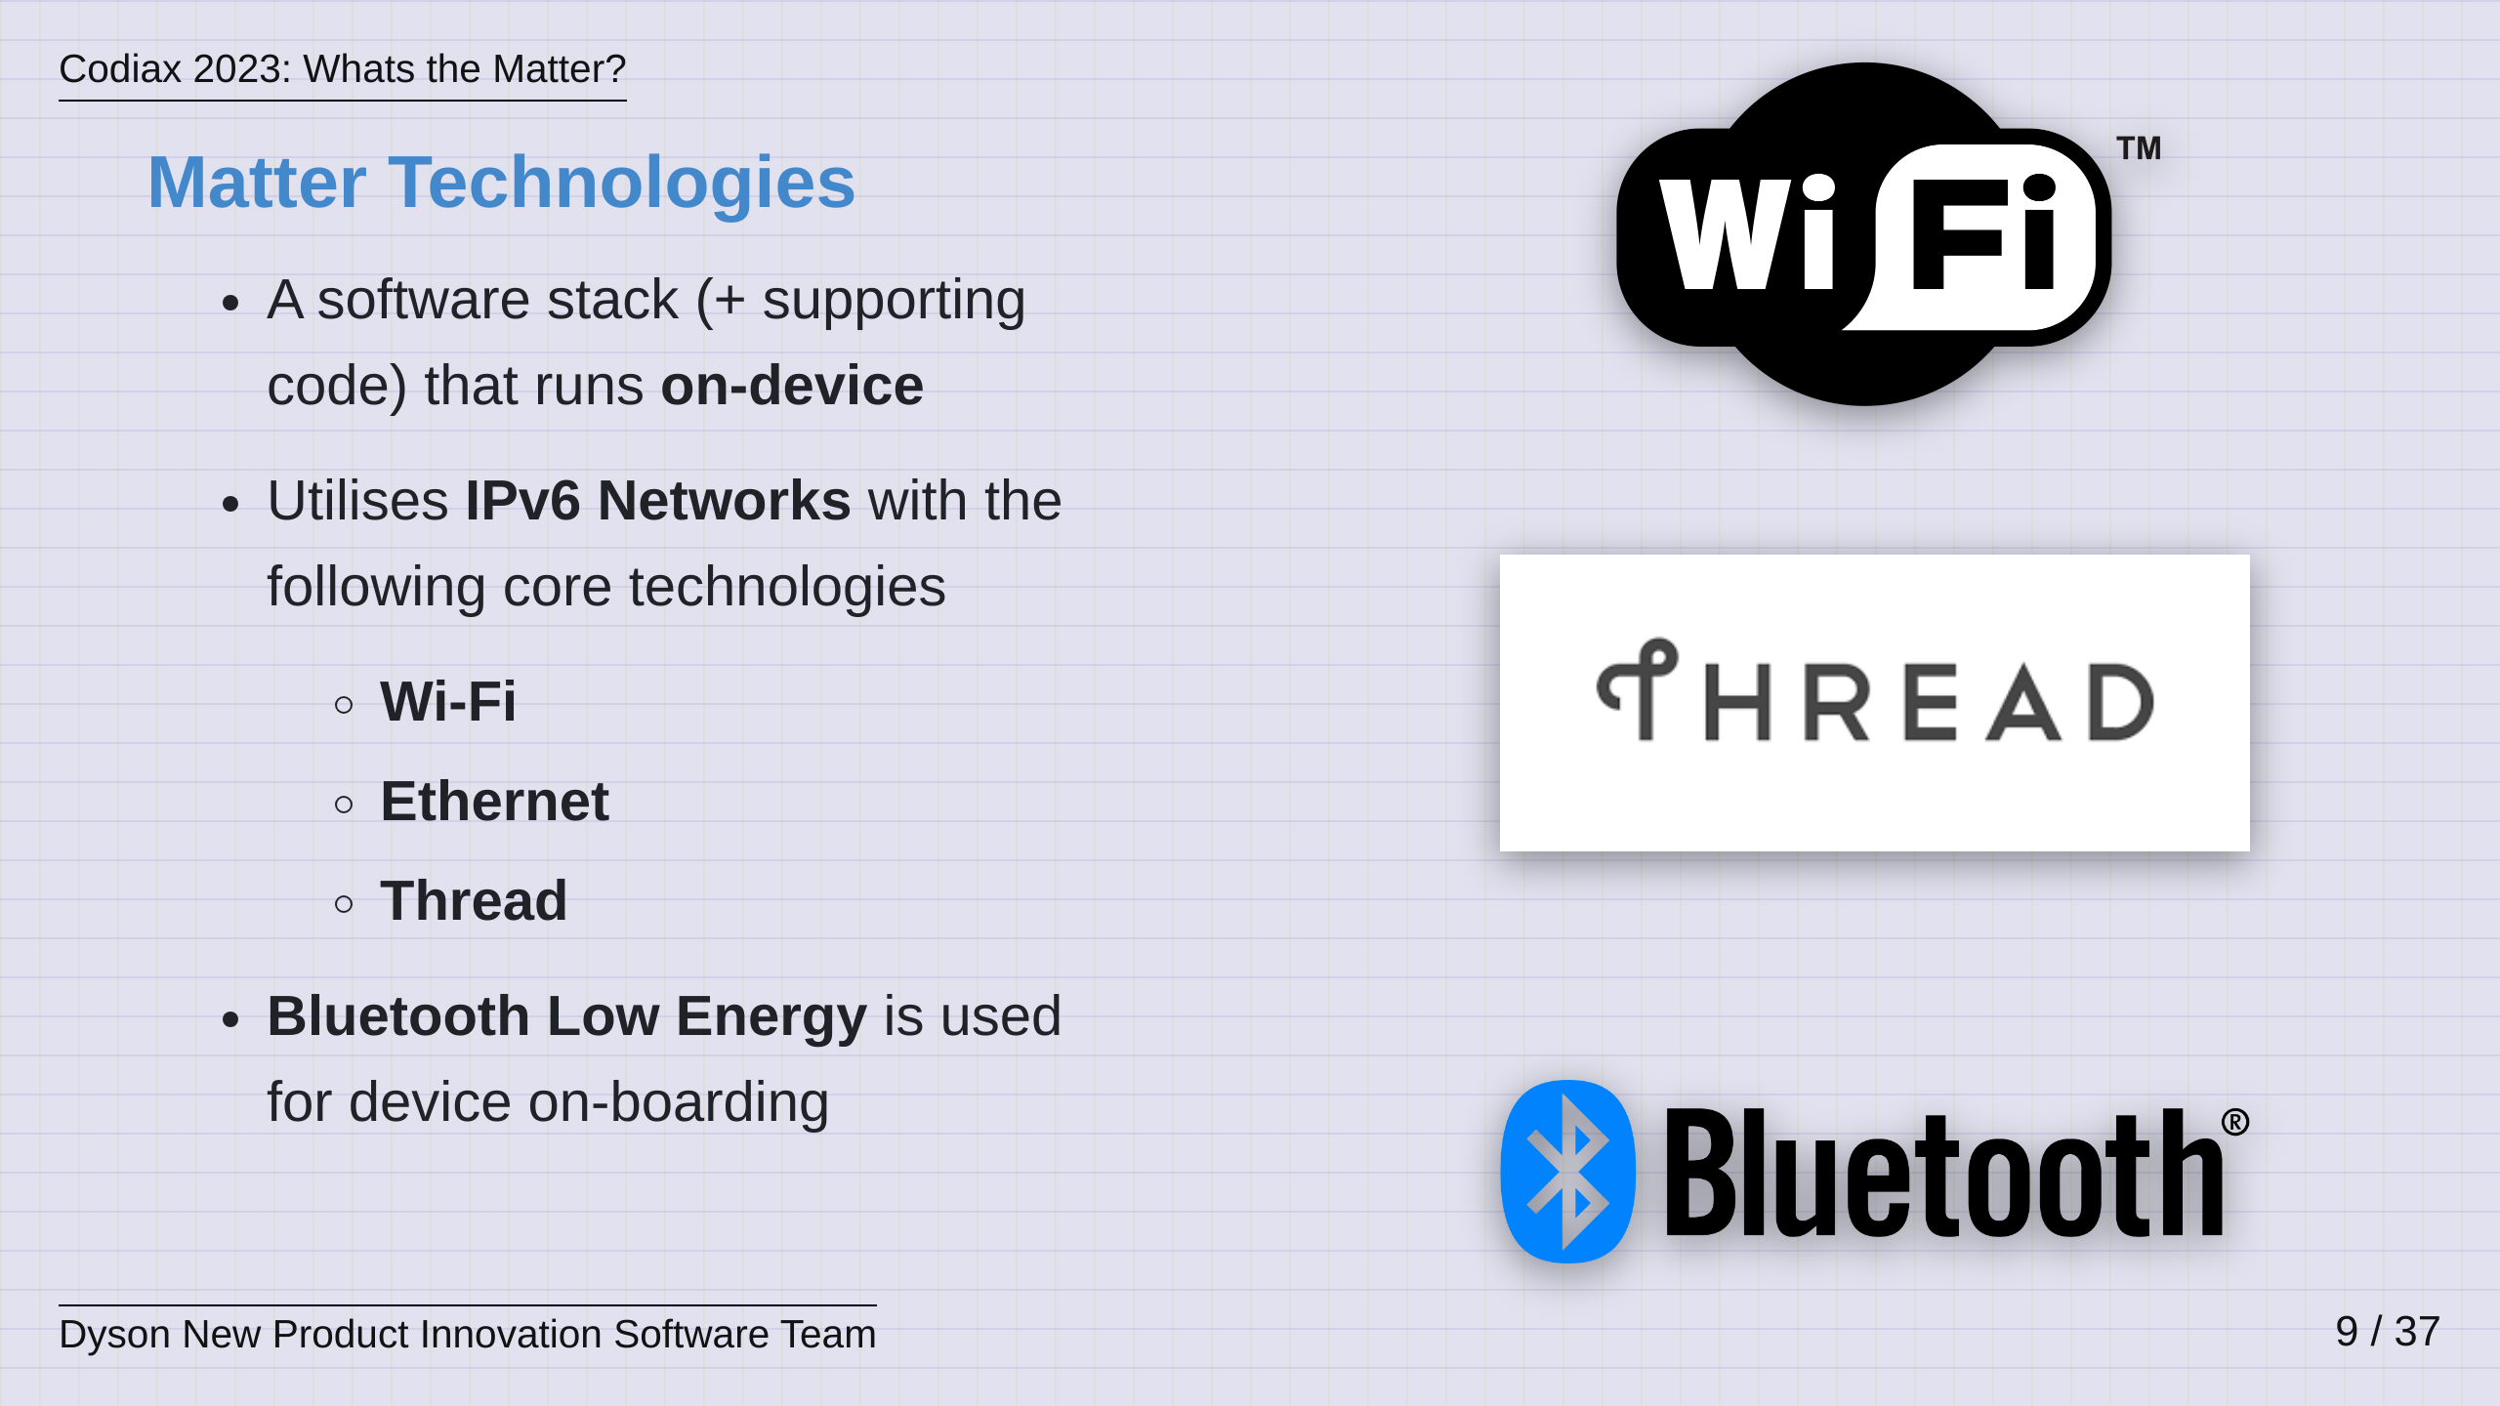
Notes:
So, Matter is a software stack that runs on a Smart Home device, embedded within the Firmware. Matter is also a software stack that runs on your phones and smart hubs in order to interact with these devices. Matter uses IPv6 at its core and the technologies that enable its connectivity are Wi-Fi, Ethernet and Thread. Bluetooth Low Energy is used for device on-boarding. A little history here, this idea of mulitple, interconnected IPv6 link technologies was introduced by Nest Labs in 2014 under the name Weave which then ended up at Google when they acquired Nest. Weave development has been superceded by Matter but its interconnected ethos lives at the very core of Matter. Now, I am going to make an educated guess that the majority of people here are familiar with Wi-Fi, Ethernet and Bluetooth. Typically Thread is the one that less people have heard of so I thought I would take a moment to give you an overview of Thread.

Slide 10
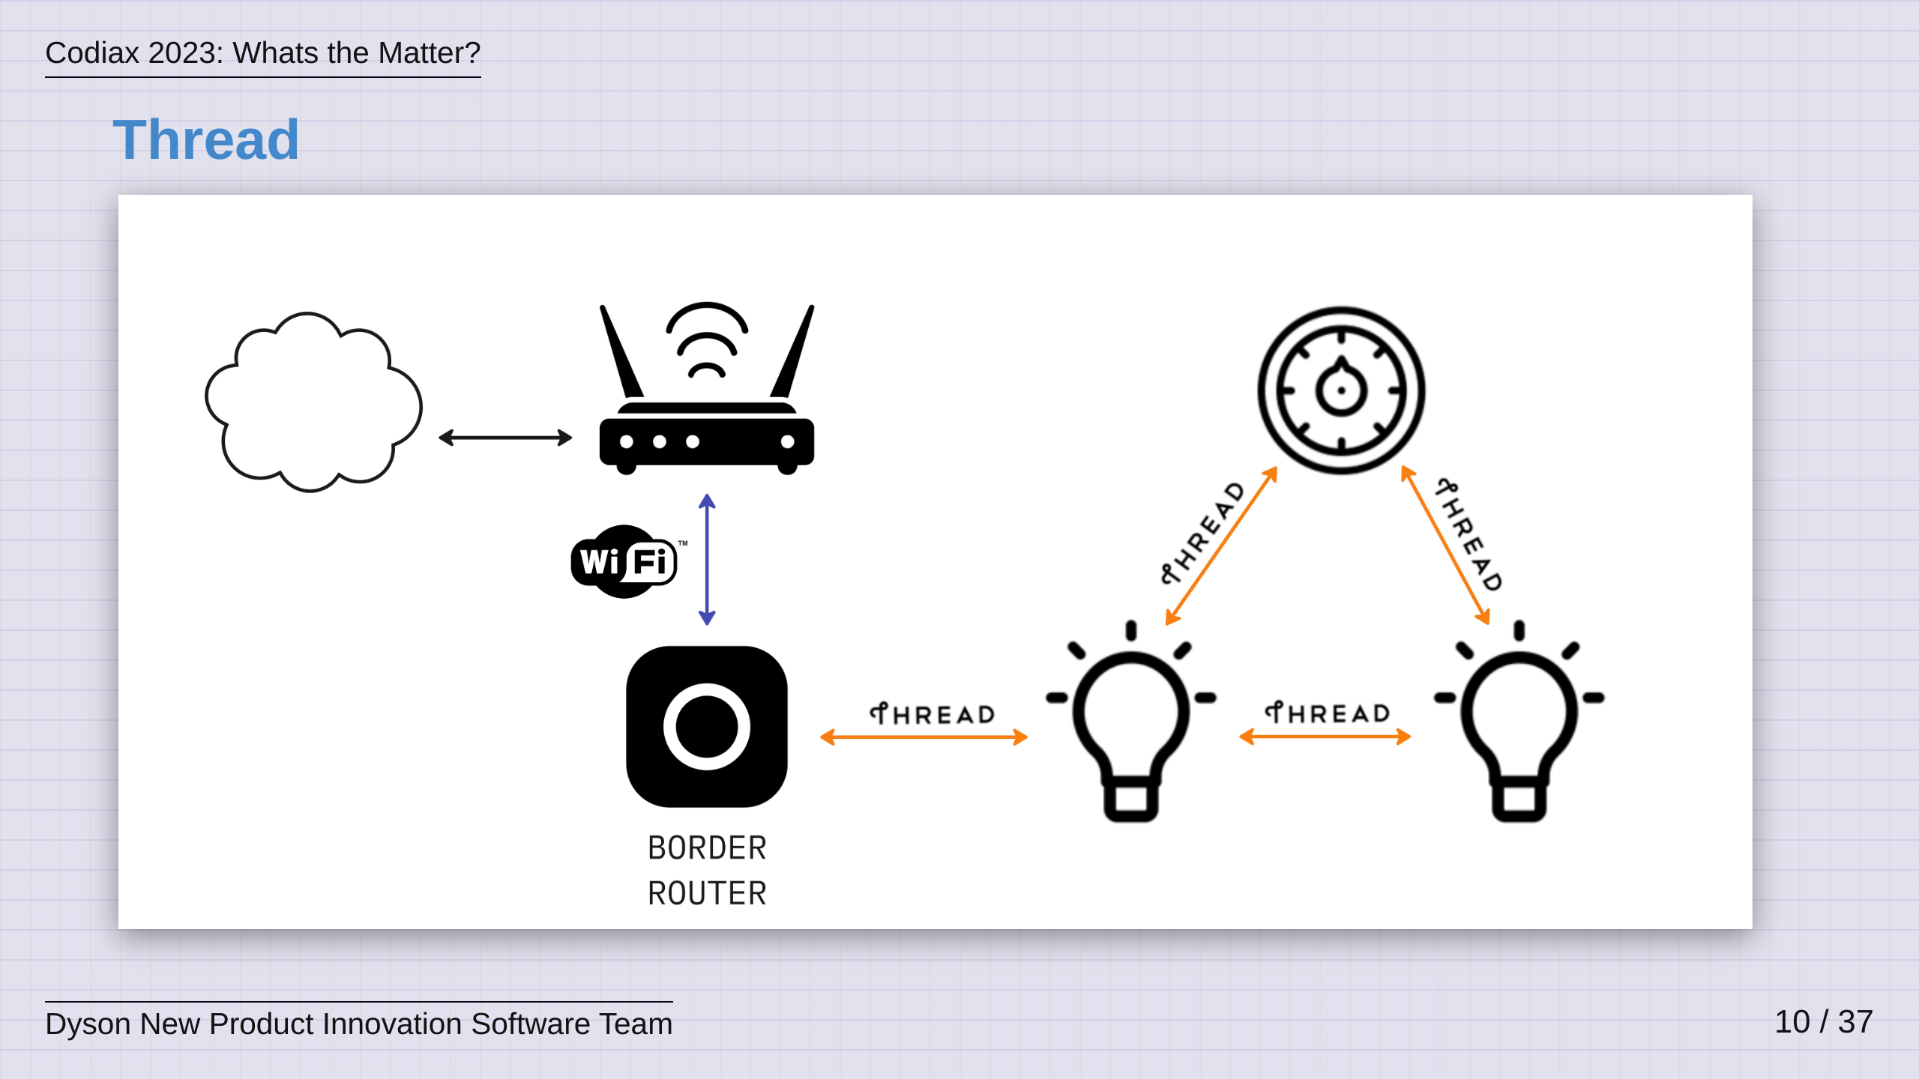
Notes:
Thread is a low power, meshing technology based on 802.15.4 which, if any of you have heard of Zigbee, this is basically the same physical radio layer as Zigbee So in a way, its effectively Zigbee, except that Thread uses IPv6 for communication, exactly like like a standard Wi-Fi or Ethernet network that we are used to in our everyday lives. Thread is then bridged back into a standard Wi-Fi or Ethernet network by a device called a Border Router, which is like a hub that runs both Thread and Wi-Fi or Ethernet allowing it to understand and bridge both technologies. Thread is exciting, because it allows low power devices to form a mesh network around the home and then communicate with devices on the main network via this Border Router Hub. This leads to robust networks with very little downtime due to the mesh based connectivity. ​ So, now that we know waht Thread is, we can look at a typical Matter network

Slide 11
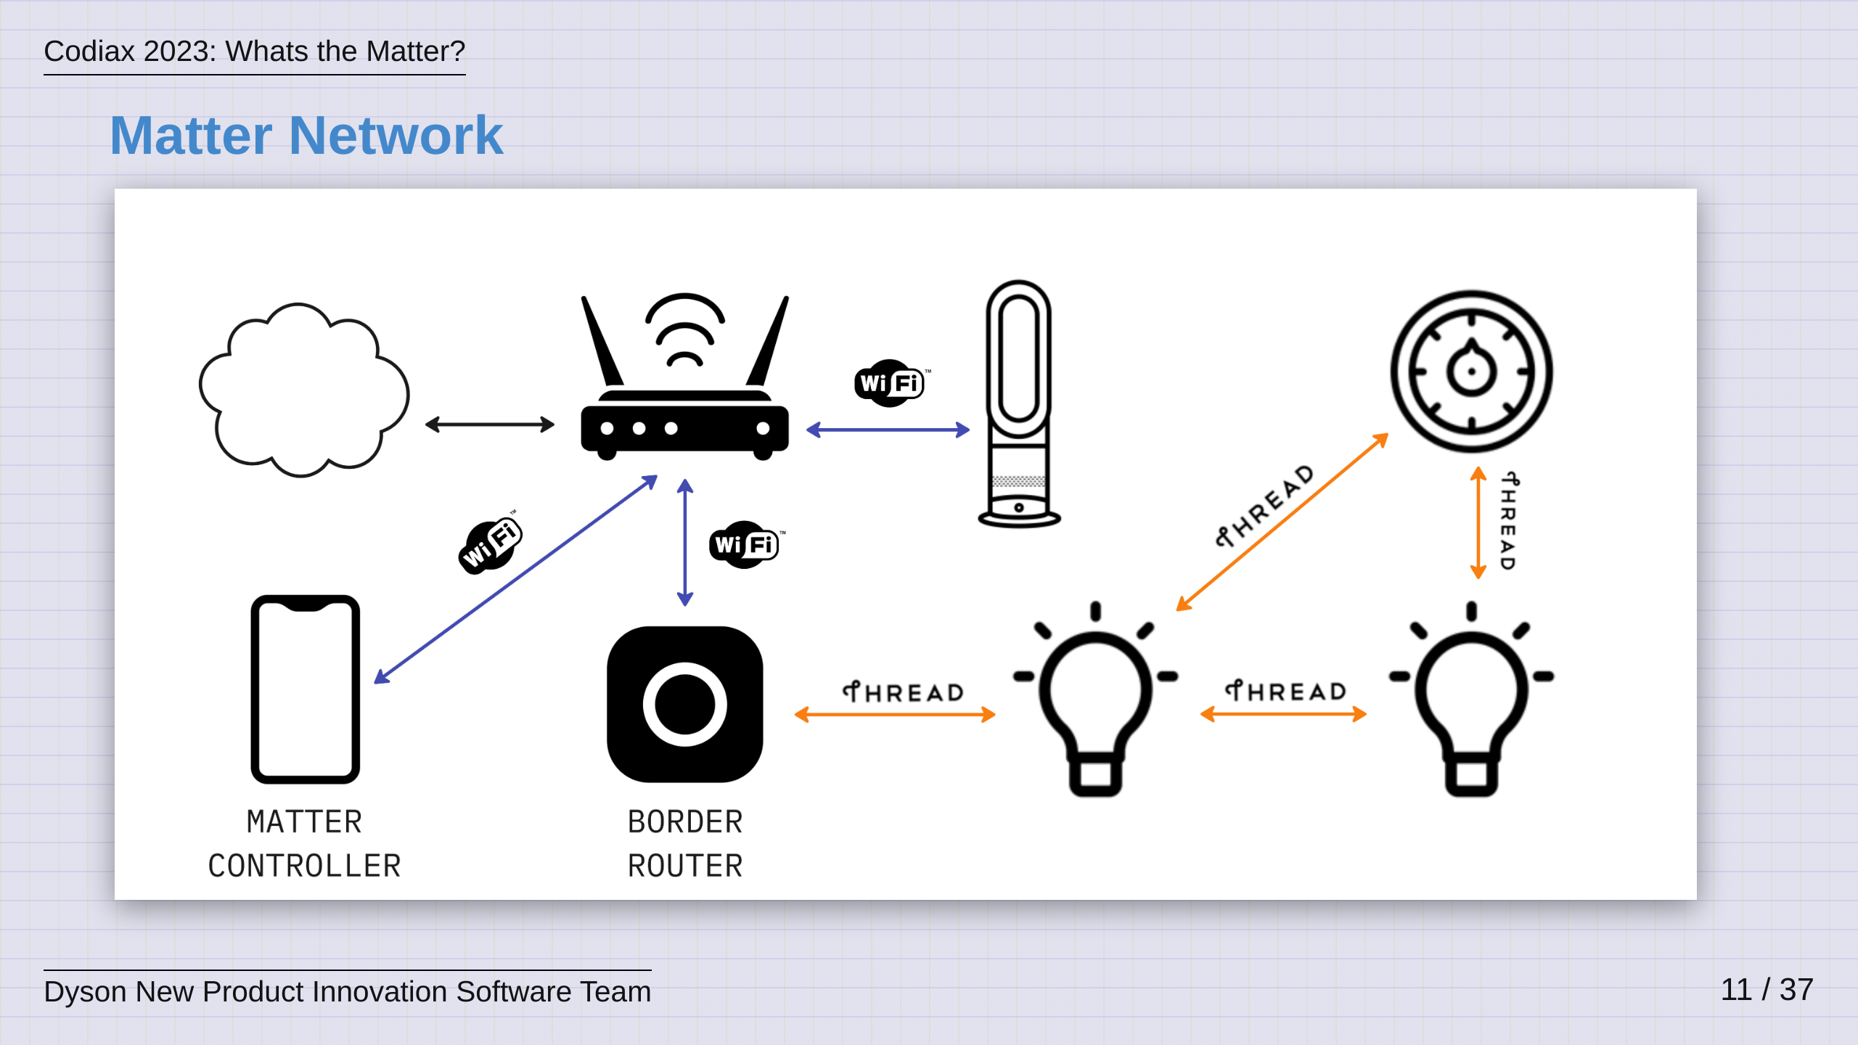
Notes:
As we described before, here you see Wi-Fi and Thread devices, connected together on the same Local Area Network. Here we've introduced the Matter Controller. If we think of the devices as "servers", then the Matter Controller is the "client", allowing users like you and me to interact with, and control, the devices on the network. We can also see the Thread Border Router Hub that we discussed before, bridging the thread devices into the network, allowing all devices to communicate using Matter. So, I know what a lot of you are probably thinking, this hub just feels like another piece of hardware that users are going to have to buy. Well, thats the beauty of it, most users already have one at home.

Slide 12
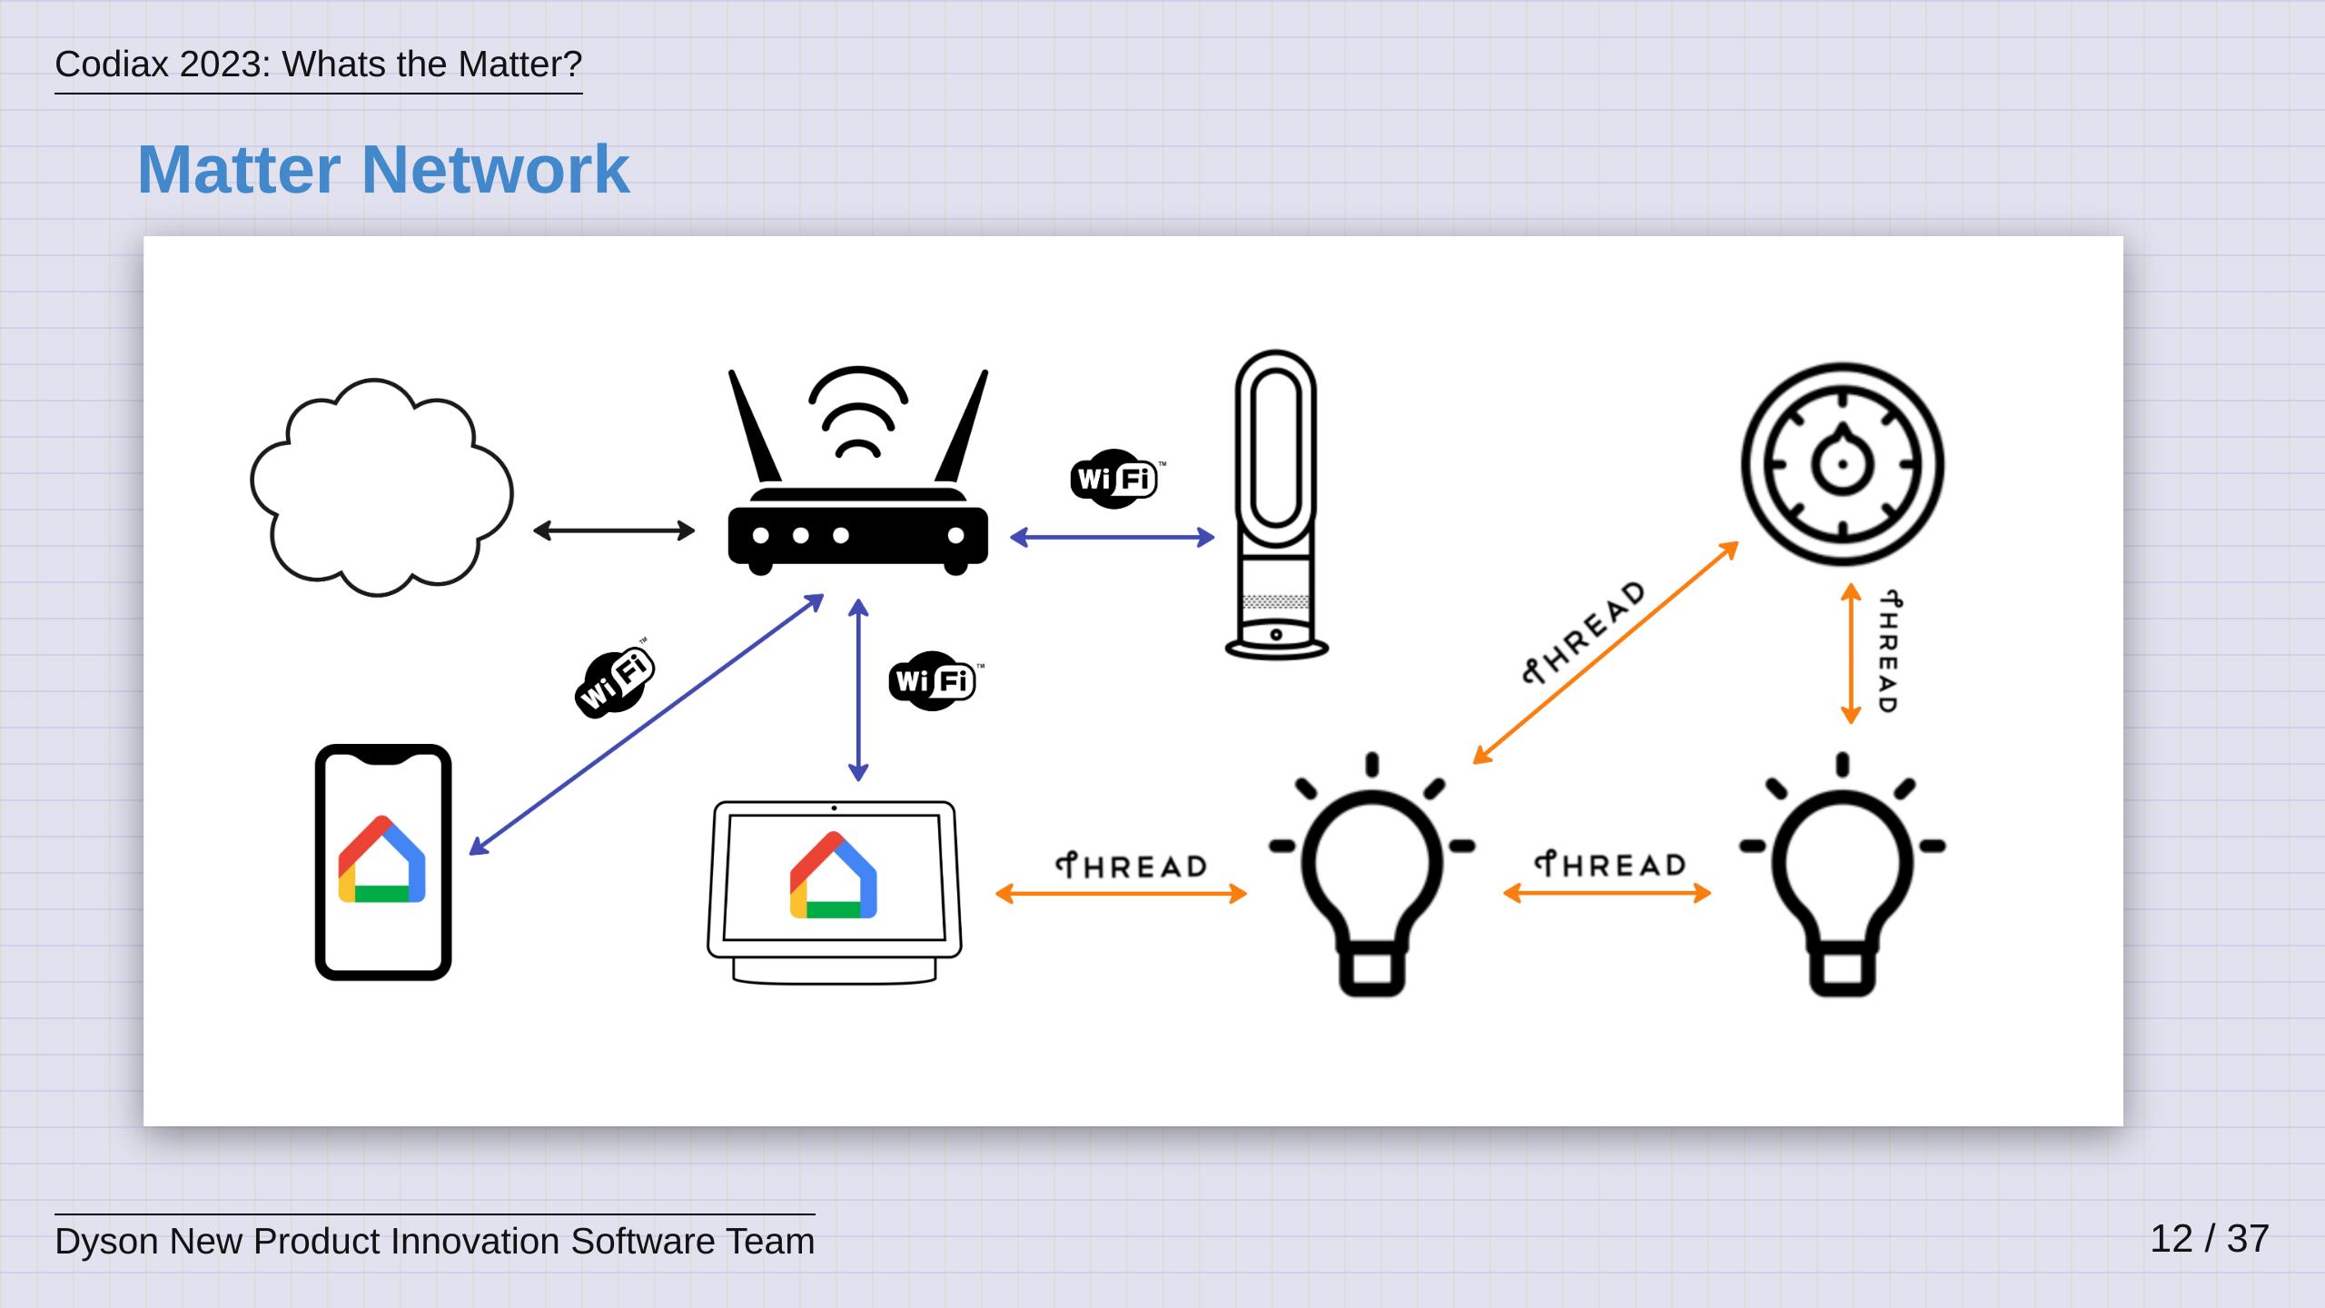
Notes:
These border routers are simply built in to the various smart home hubs and speakers that a lot of users already have on their networks today. For example, here we see a Google Nest Display and Smart Speaker inj the network alongside Googles Home app...

Slide 13
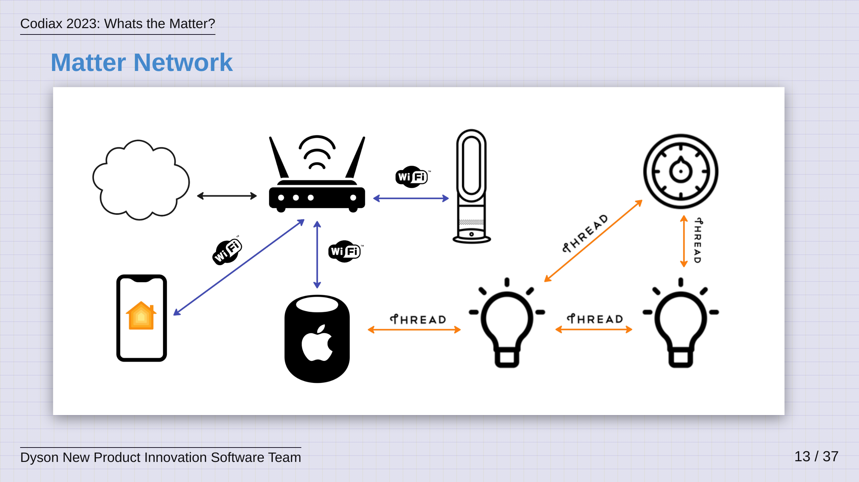
Notes:
...and here we see the exact same network centered around an Apple Home Pod and the iOS Home App. These are real world examples and they already paint a picture of how Matter allows the consumer to have complete choice on which platform they want to use, without requiring multiple integrations on the device side. I think you'll agree, this not only makes things simpler for the consumer, but also the device manufacturers!

Slide 14
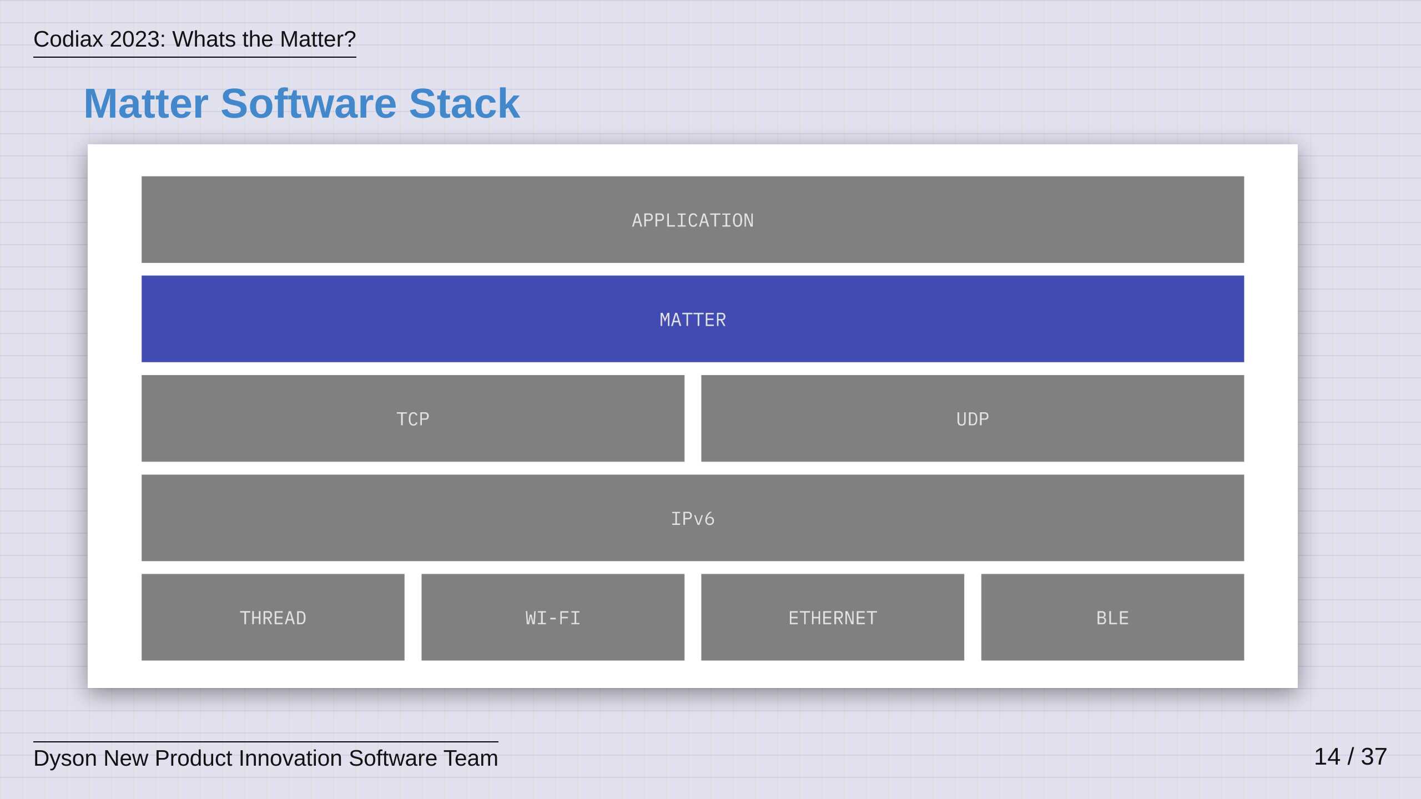
Notes:
So, as discussed before, Matter is a software stack. I wanted to try and take some time to show you how Matter leverages existing, battle tested technologies in order to integrate seamlessly. Here you see a zoomed out Matter Software stack illustrating where Matter fits in. Above Matter, you have an application, and this is typically the firmware running on a device or the application running on a mobile phone. Matter provides easy hooks for an application to plug its business logic, into the protocol. Then below Matter, we have technologies that form the core of all the networks we use today, TCP, UDP and IP are the backbone of nearly all internet communications and these can all run seamlessly on the technologies that we describes before, Wi-Fi, Thread, etc This begins to paint the picture of a ubiqitous protocol, built around common and standardised technologies.

Slide 15
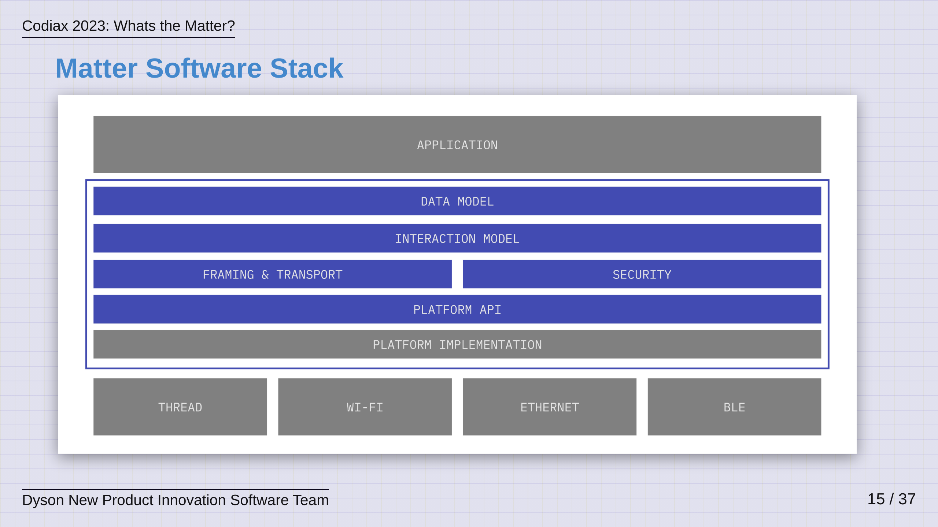
Notes:
If we zoom in some more, we can begin to see the building blocks that make this protocol easy to interpret and communicate with. Typically devices and clients are built on a platform, this may be a microcontroller, a linux computer like a raspberry pi or an android or iOS phone. Matter provides a standard Programming Interface, or API, for a platform and as such, platform vendors like chip suppliers and phone operating system developers implement a version of this to run on their platform. Making this a standard API means that all the layers above it can become standardised across the board. We can see this here, with Matter's Framing, Transport and Security layers all sitting on top of this common Platform API. Following this, a common protocol then needs what is known as its Application Layer, and in Matter, this is broken down into an Interaction Model and a Data Model, which we'll now examine further.

Slide 16
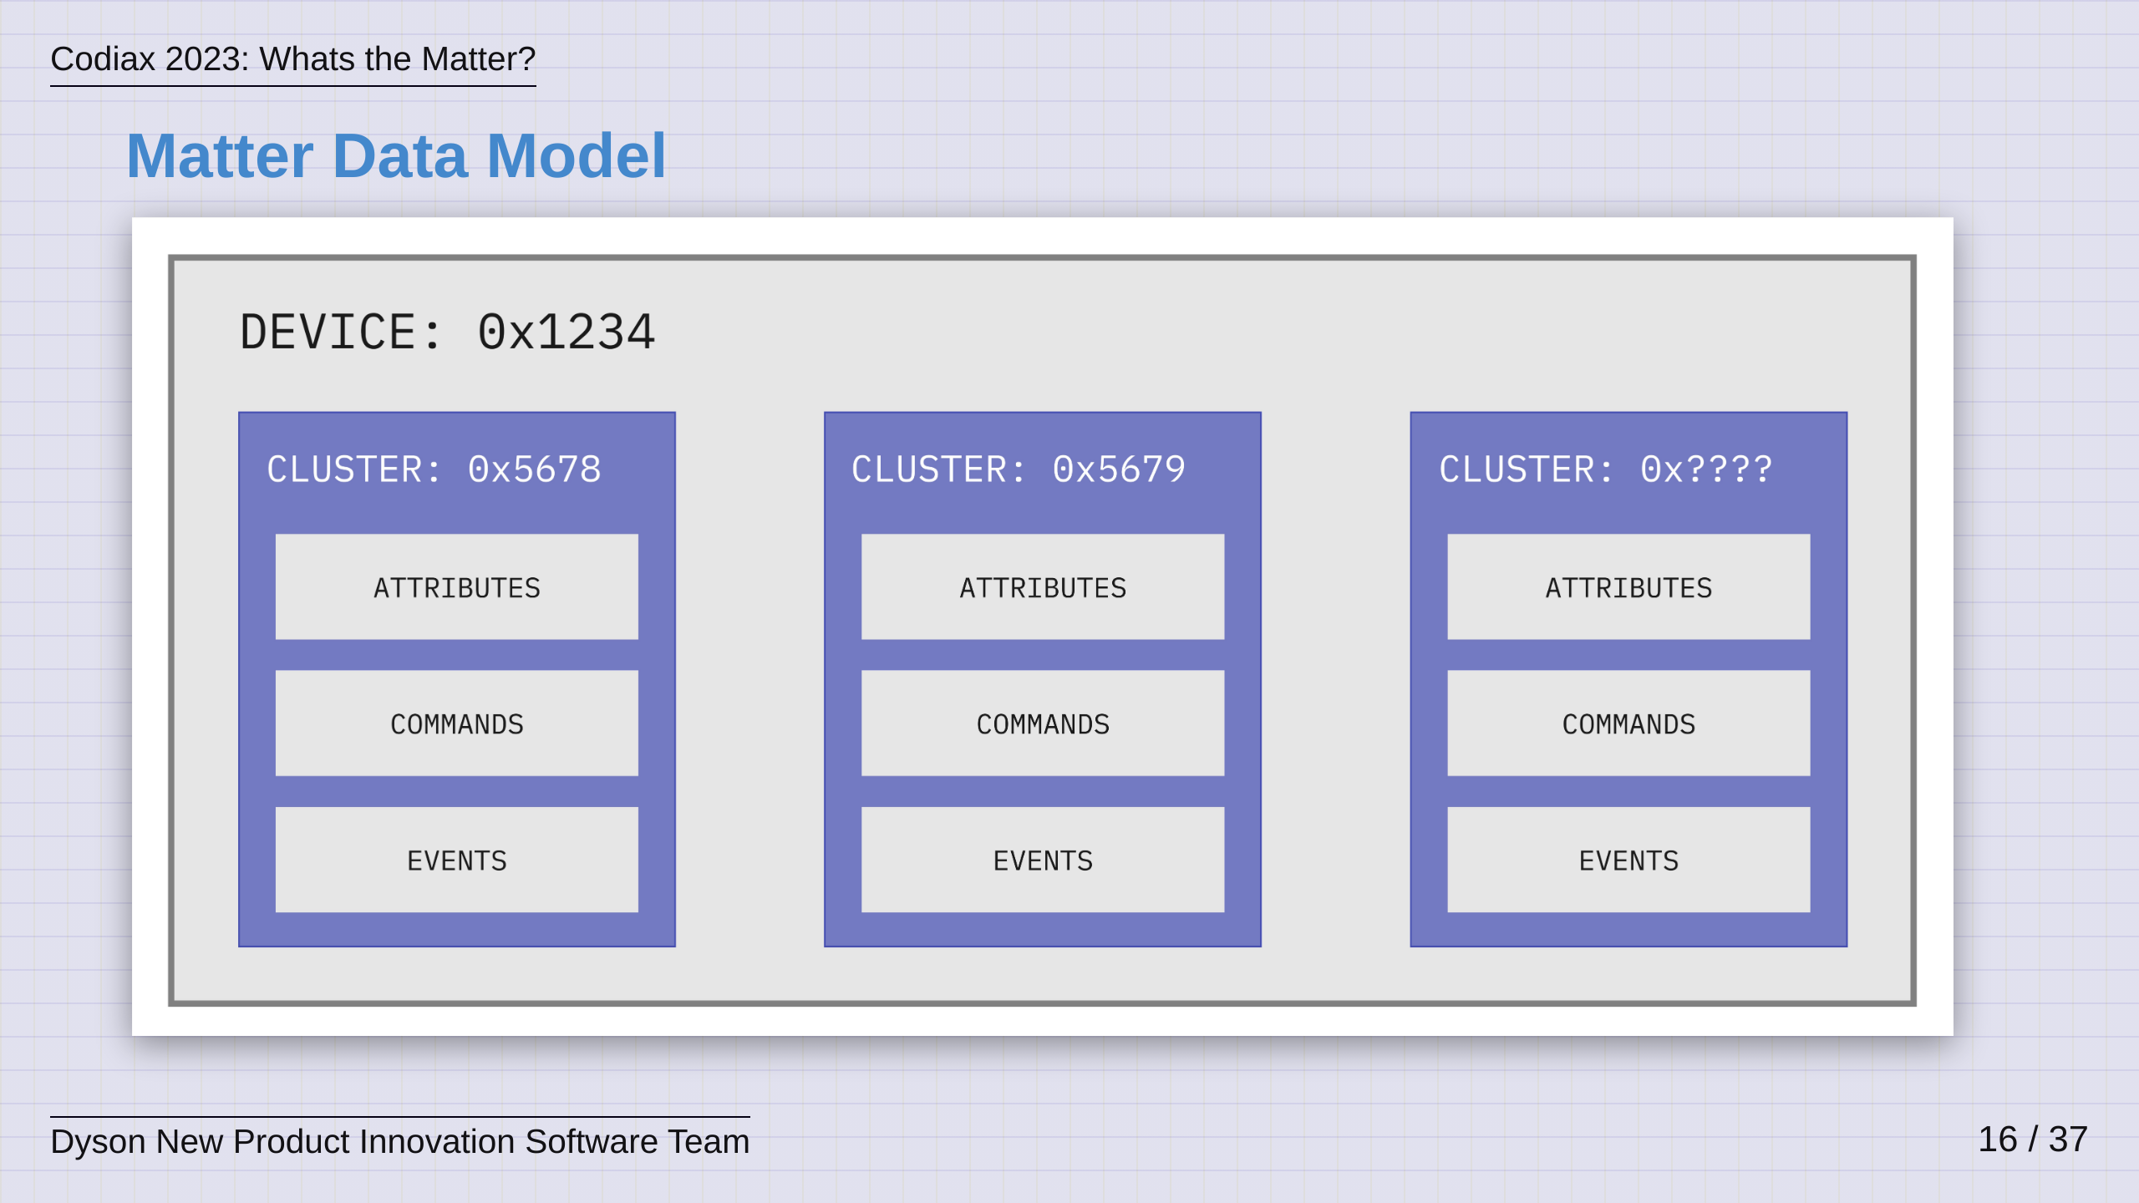
Notes:
As we've stated. Matter's goal is to enable common communication with devices. For it to do this, it needs to have a robust and common way to represent devices and this is known as the Data Model. The clue is in the name really, it allows developers of the Matter standard to use a set of building blocks to model a device. These building blocks are known as clusters, which are distinct blocks of functionality grouped together as Attributes, Commands and Events. These clusters are unique and device types are built up as a collection of them. This is a little bit like Bluetooth Low Energy Services and Characteristics, if anyone is familiar with that. So, what does this like in reality?

Slide 17
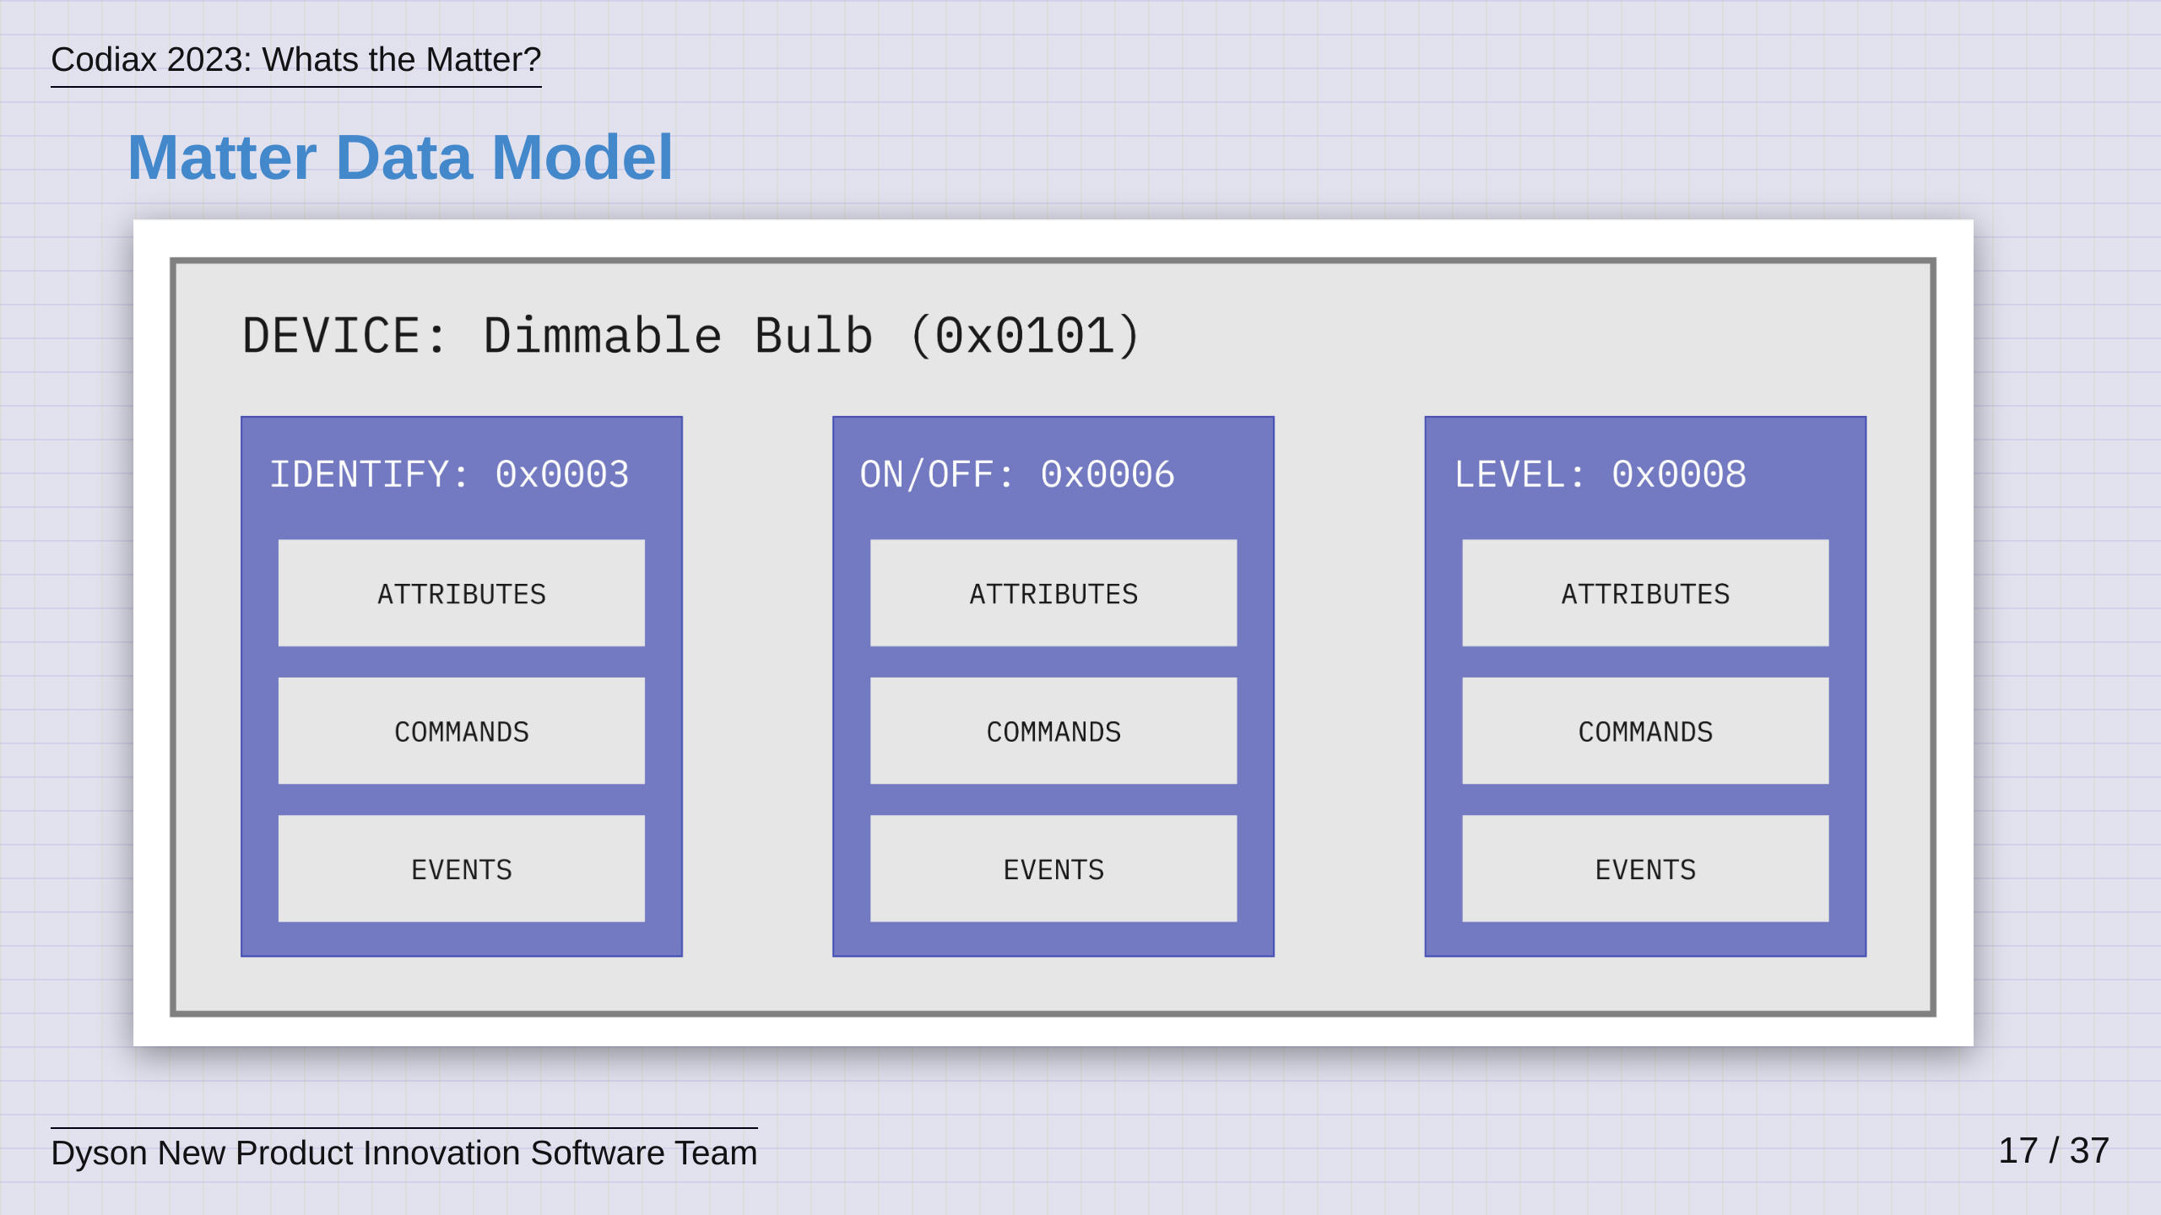
Notes:
Here we see the representation of a very common Matter device, a Dimmable Bulb. So, if you wish to build a Dimmable Bulb that is Matter compatible, then you must expose the following three clusters. - On/Off, which as you could guess allows the bulb to be turned on and off - Level, which given this is a "dimmable bulb", allows the level of the light output to be controlled - Identify is also there, it is used to make a product identify itself, which is always useful if you have a lot of products on a network These clusters alone have no relation to a dimmable bulb, but brought together under a Device Type ID, they represent a dimmable bulb and this gives the Matter Controllers the best shot at representing them to you the user. These clusters could then also be used in the same way to represent a simple Fan for example. Clusters should be though of as common, reusable building blocks.

Slide 18
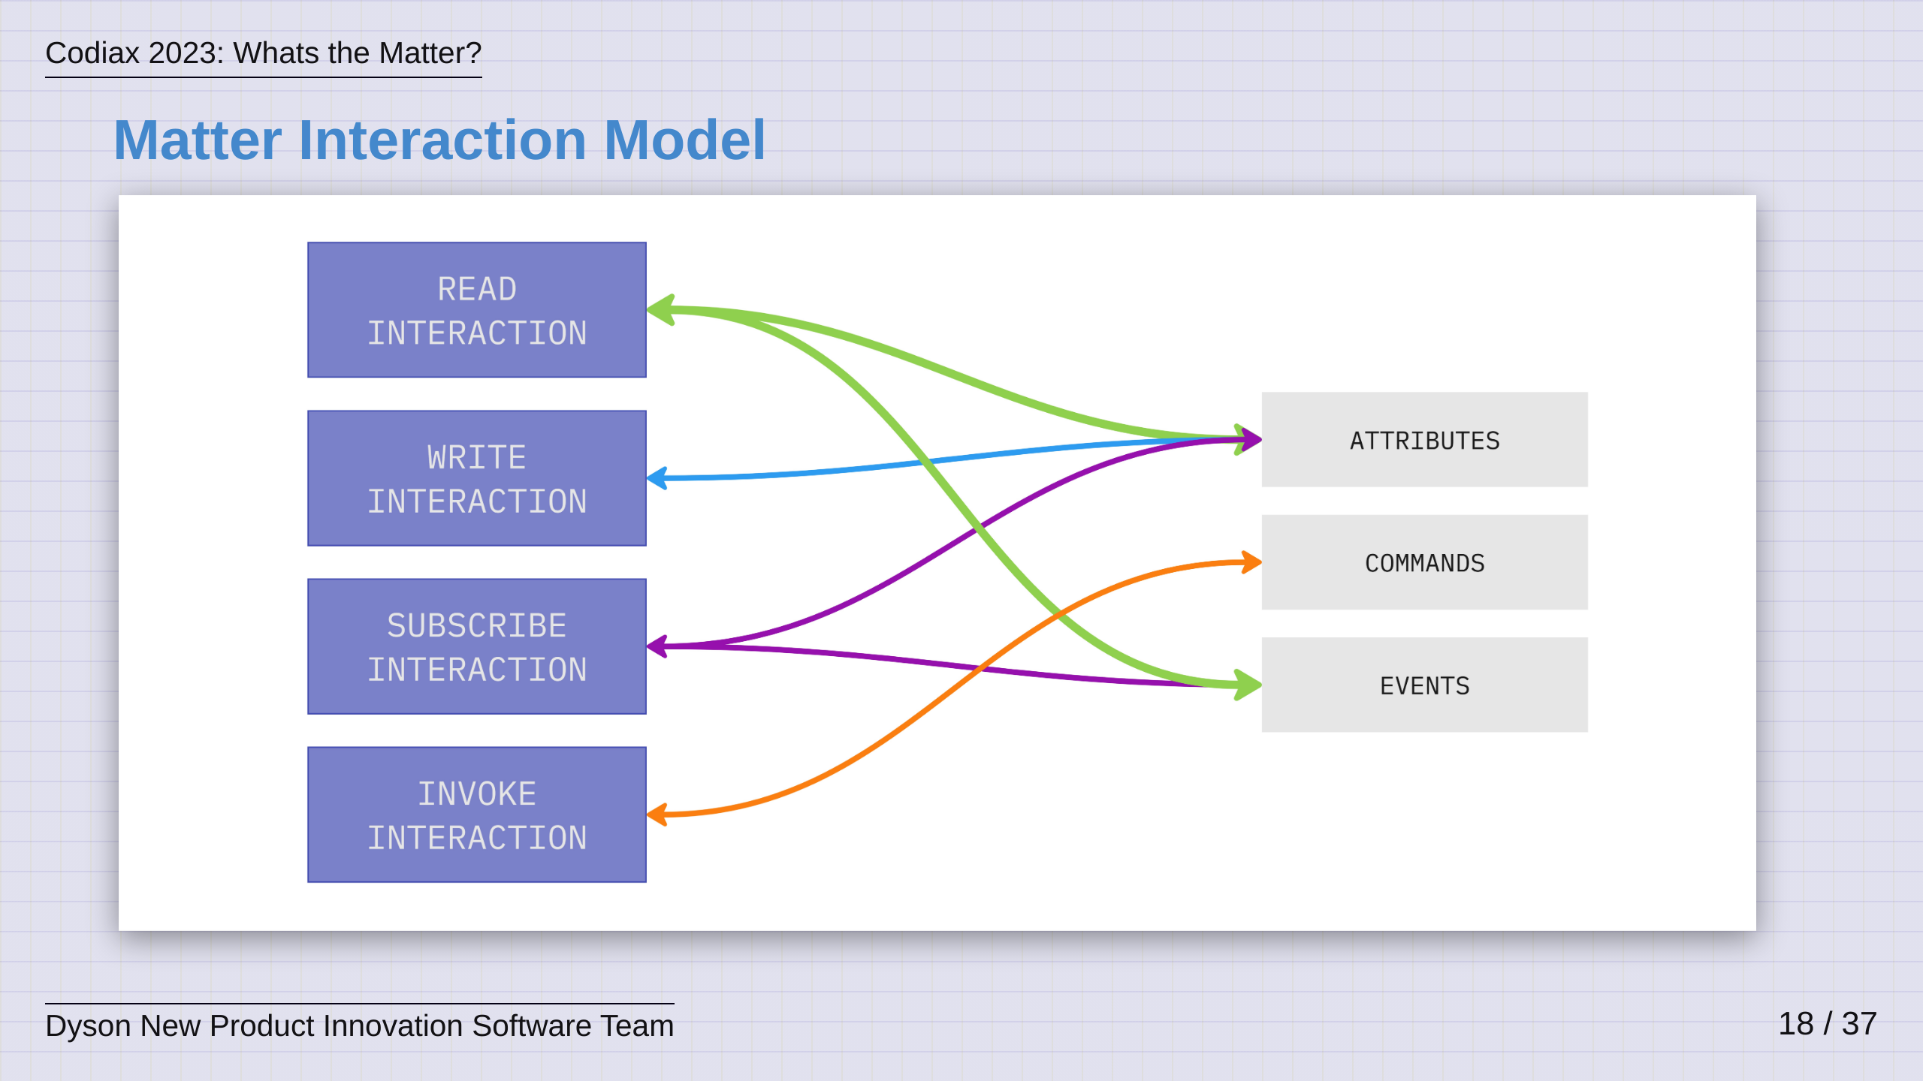
Notes:
So, given theres a common way to represent devices, there should also be a common way for controllers to interact with them. The Matter interaction model is very simple, it has Read, Write, Subscribe and Invoke. You can see how these link to the data model in the diagram. The controller can READ & SUBSCRIBE to Attrributes and Events, it can WRITE attributes and it can INVOKE commands. So, as you can see, the Data and Interaction Model combined give devices a common and ubiqitous way to be represented and interacted with.

Slide 19
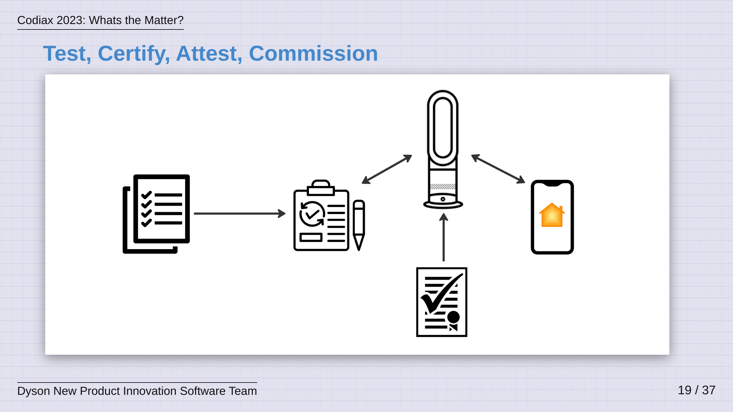
Notes:
As an aside, I don't want to cover it in great detail, but to close the loop, Matter also provides a common way to test devices, a common way to certify devices and a common way to commission devices onto a Matter network. This means that devices can be certified as genuine and can be trusted by any platform that is onboarding them, thus meaning one less thing for device manufacturers and platforms to worry about. This is how everyone wins - follow the same path!

Slide 20
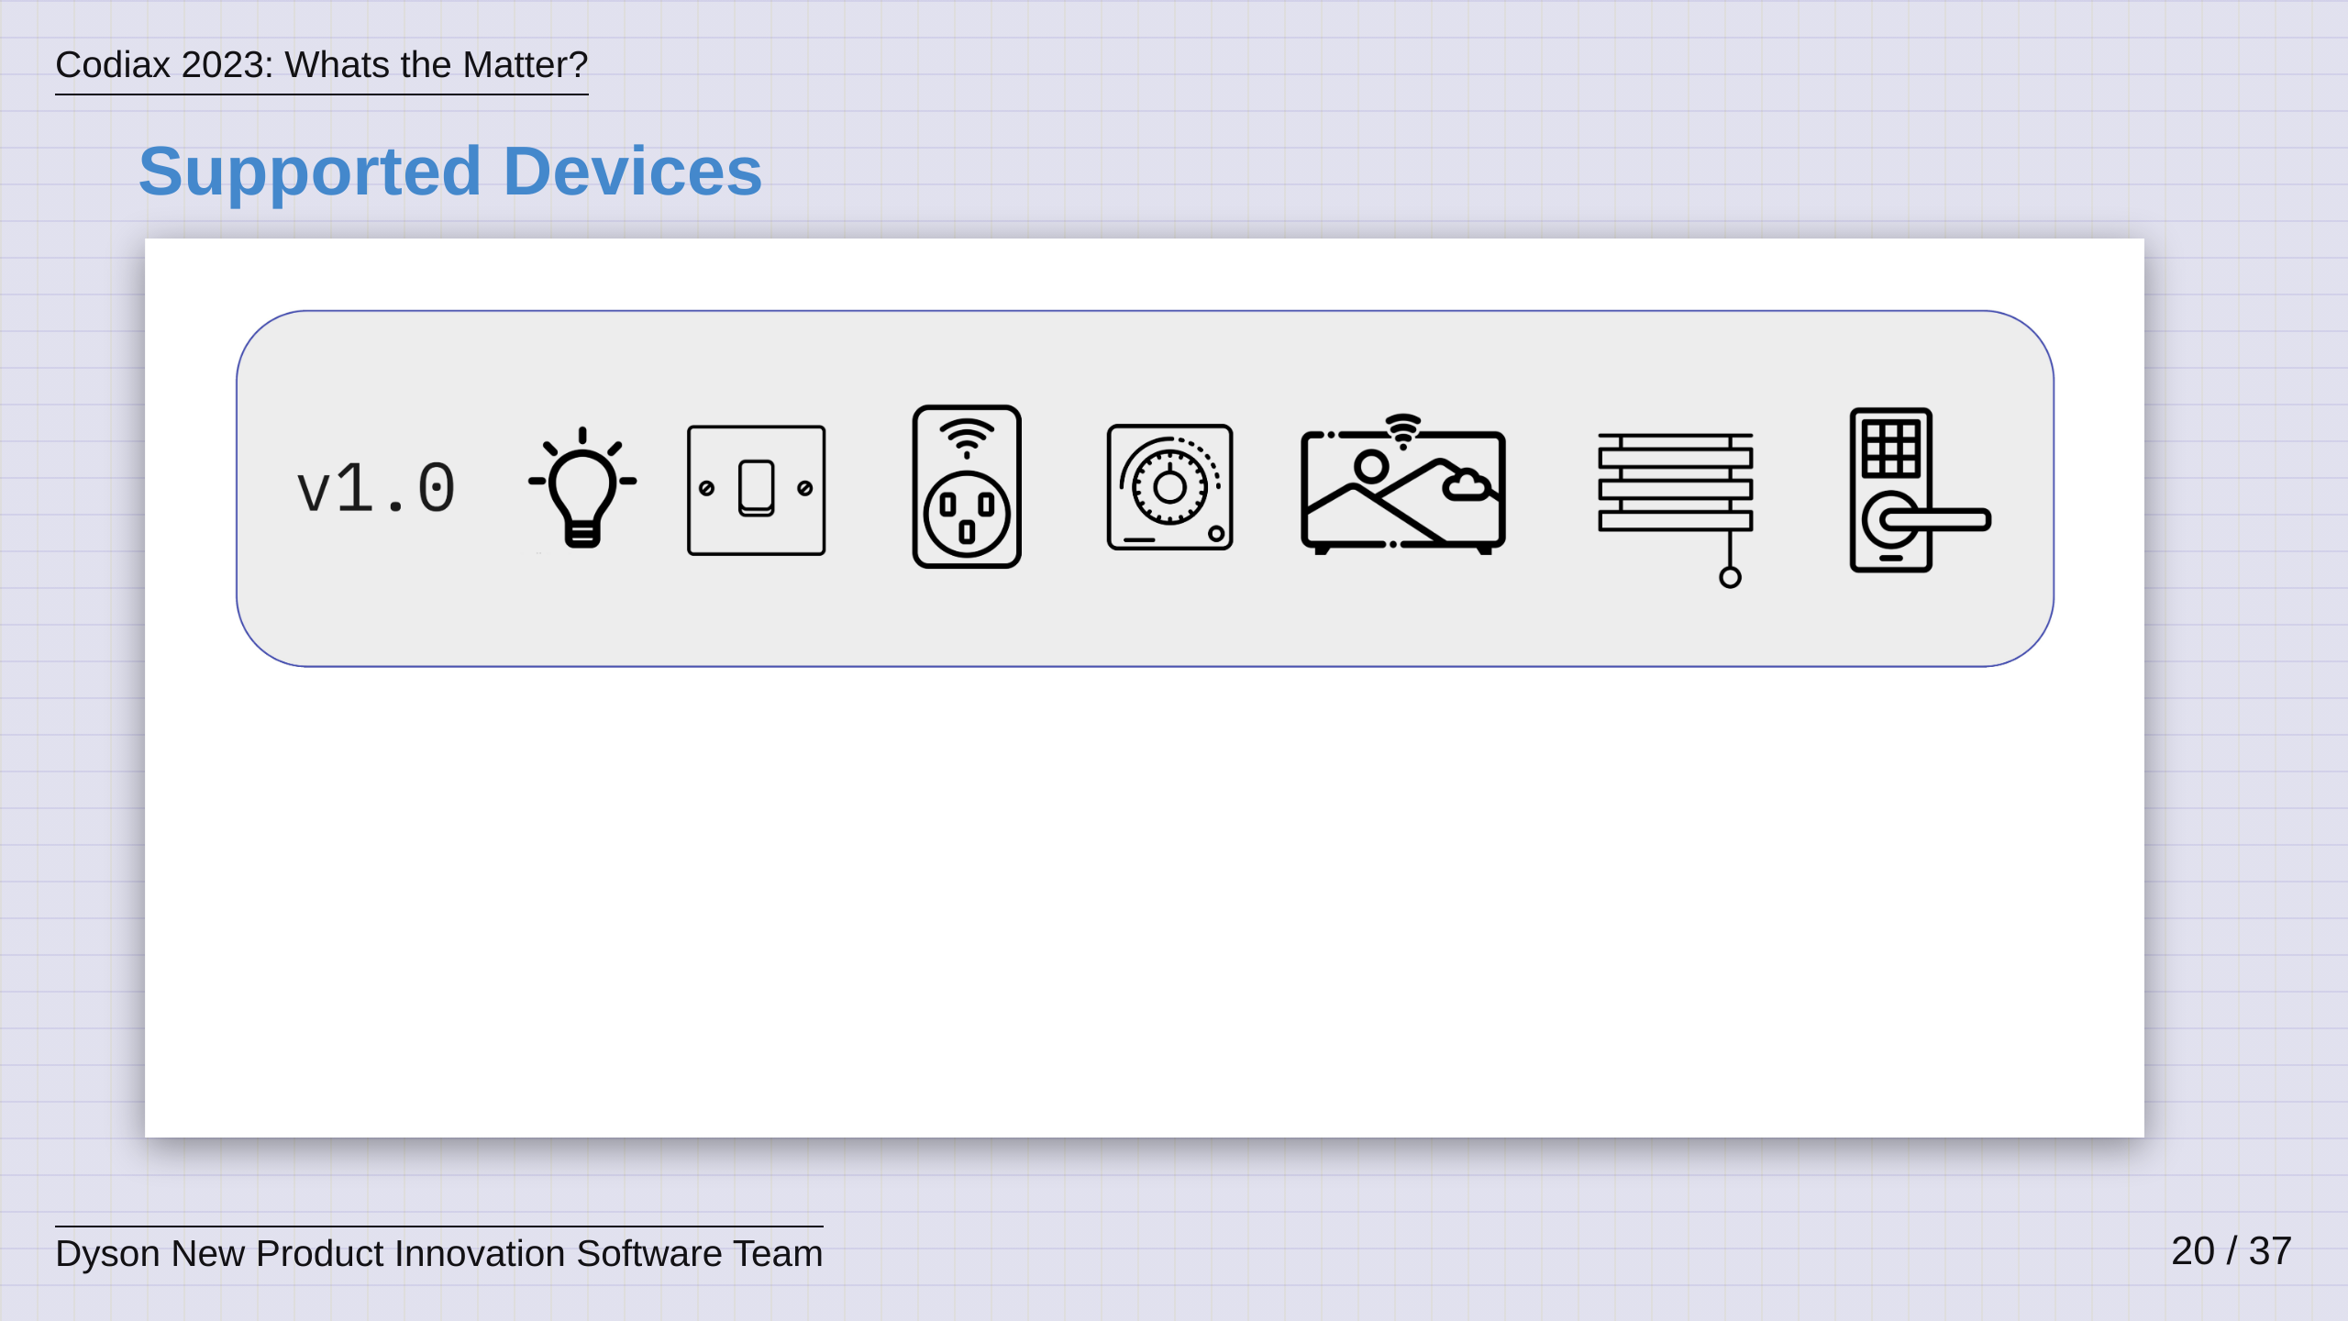
Notes:
When v1.0 of Matter was release just over a year ago, it supported a limited set of devices, namely the types that you see here: Lights, Switches, Plugs, Thermostats, TV's, Window Blinds and Door Locks.

Slide 21
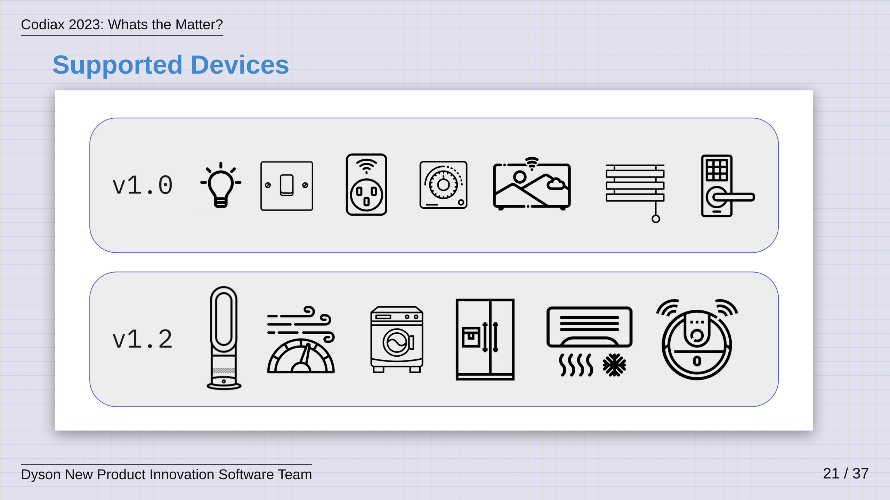
Notes:
The v1.2 release that came just a few weeks ago brought support for: Air Purifiers, Air Quality Sensors, Washing Machines, Refridgerators, Air Conditioning and Robotic Vacuum Cleaners. Dyson was directly involved in the development of v1.2...

Slide 22
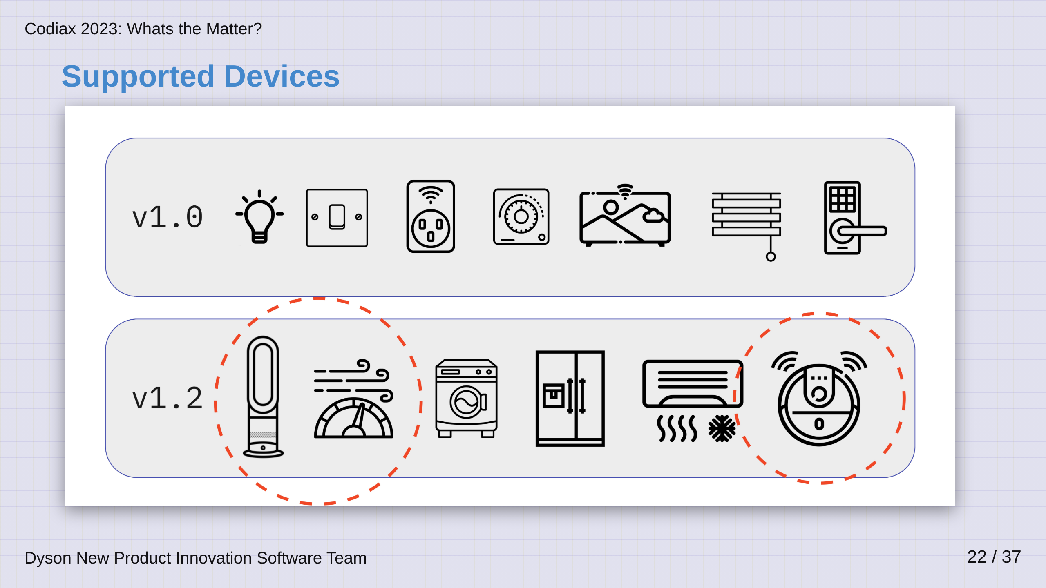
Notes:
...and for the past year of my life, my job has been to work on support for these devices, The Air Purifier, Air Quality Sensor and the Robotic Vacuum cleaner, which we will talk about briefly later on.

Slide 23
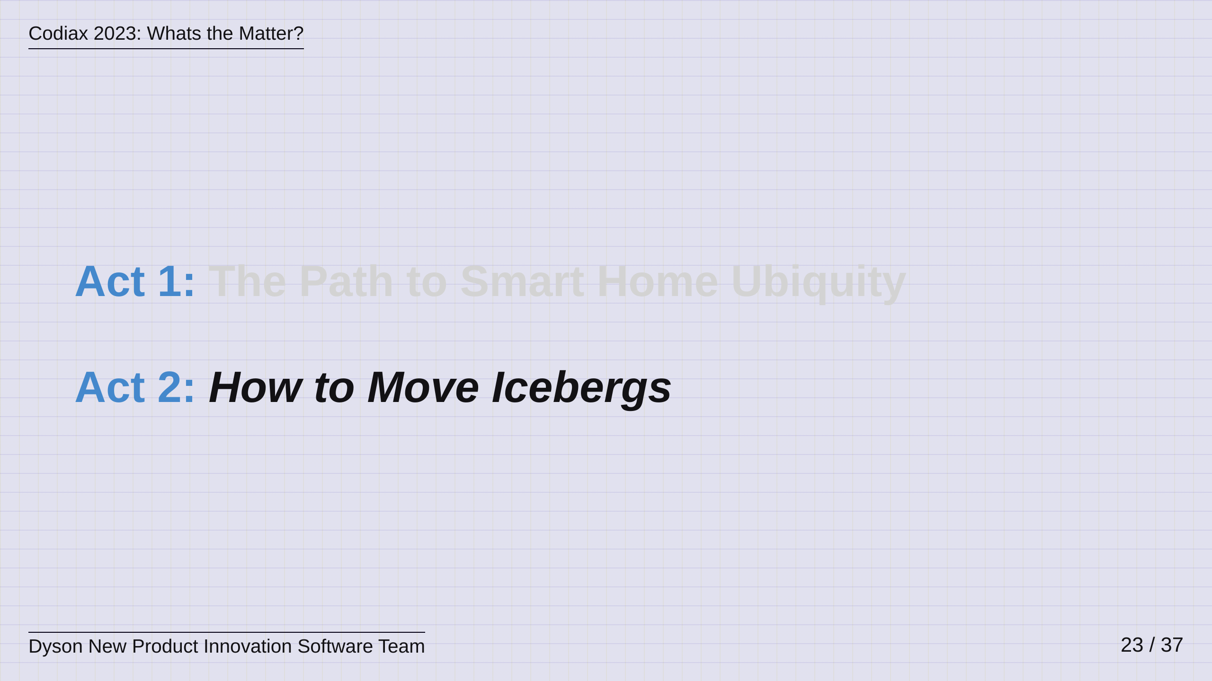
Notes:
So now that we have covered the what and the why of Matter, I'll move on to the second act, how to move icebergs.

Slide 24
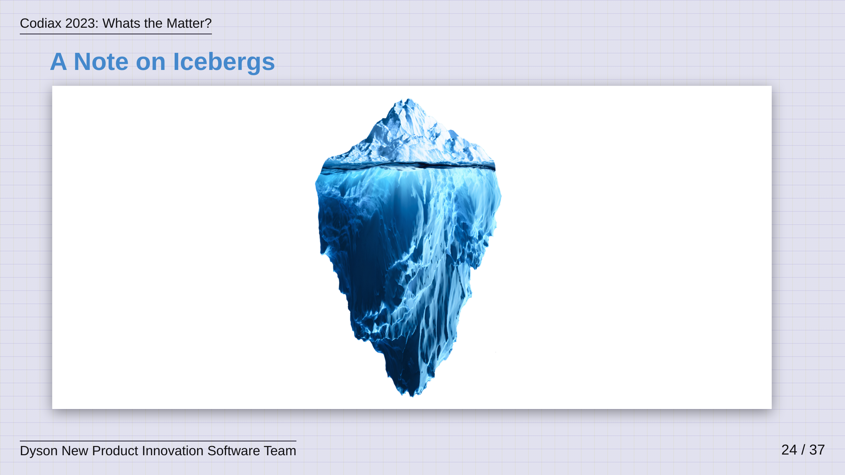
Notes:
So, first a note on Icebergs...

Slide 25
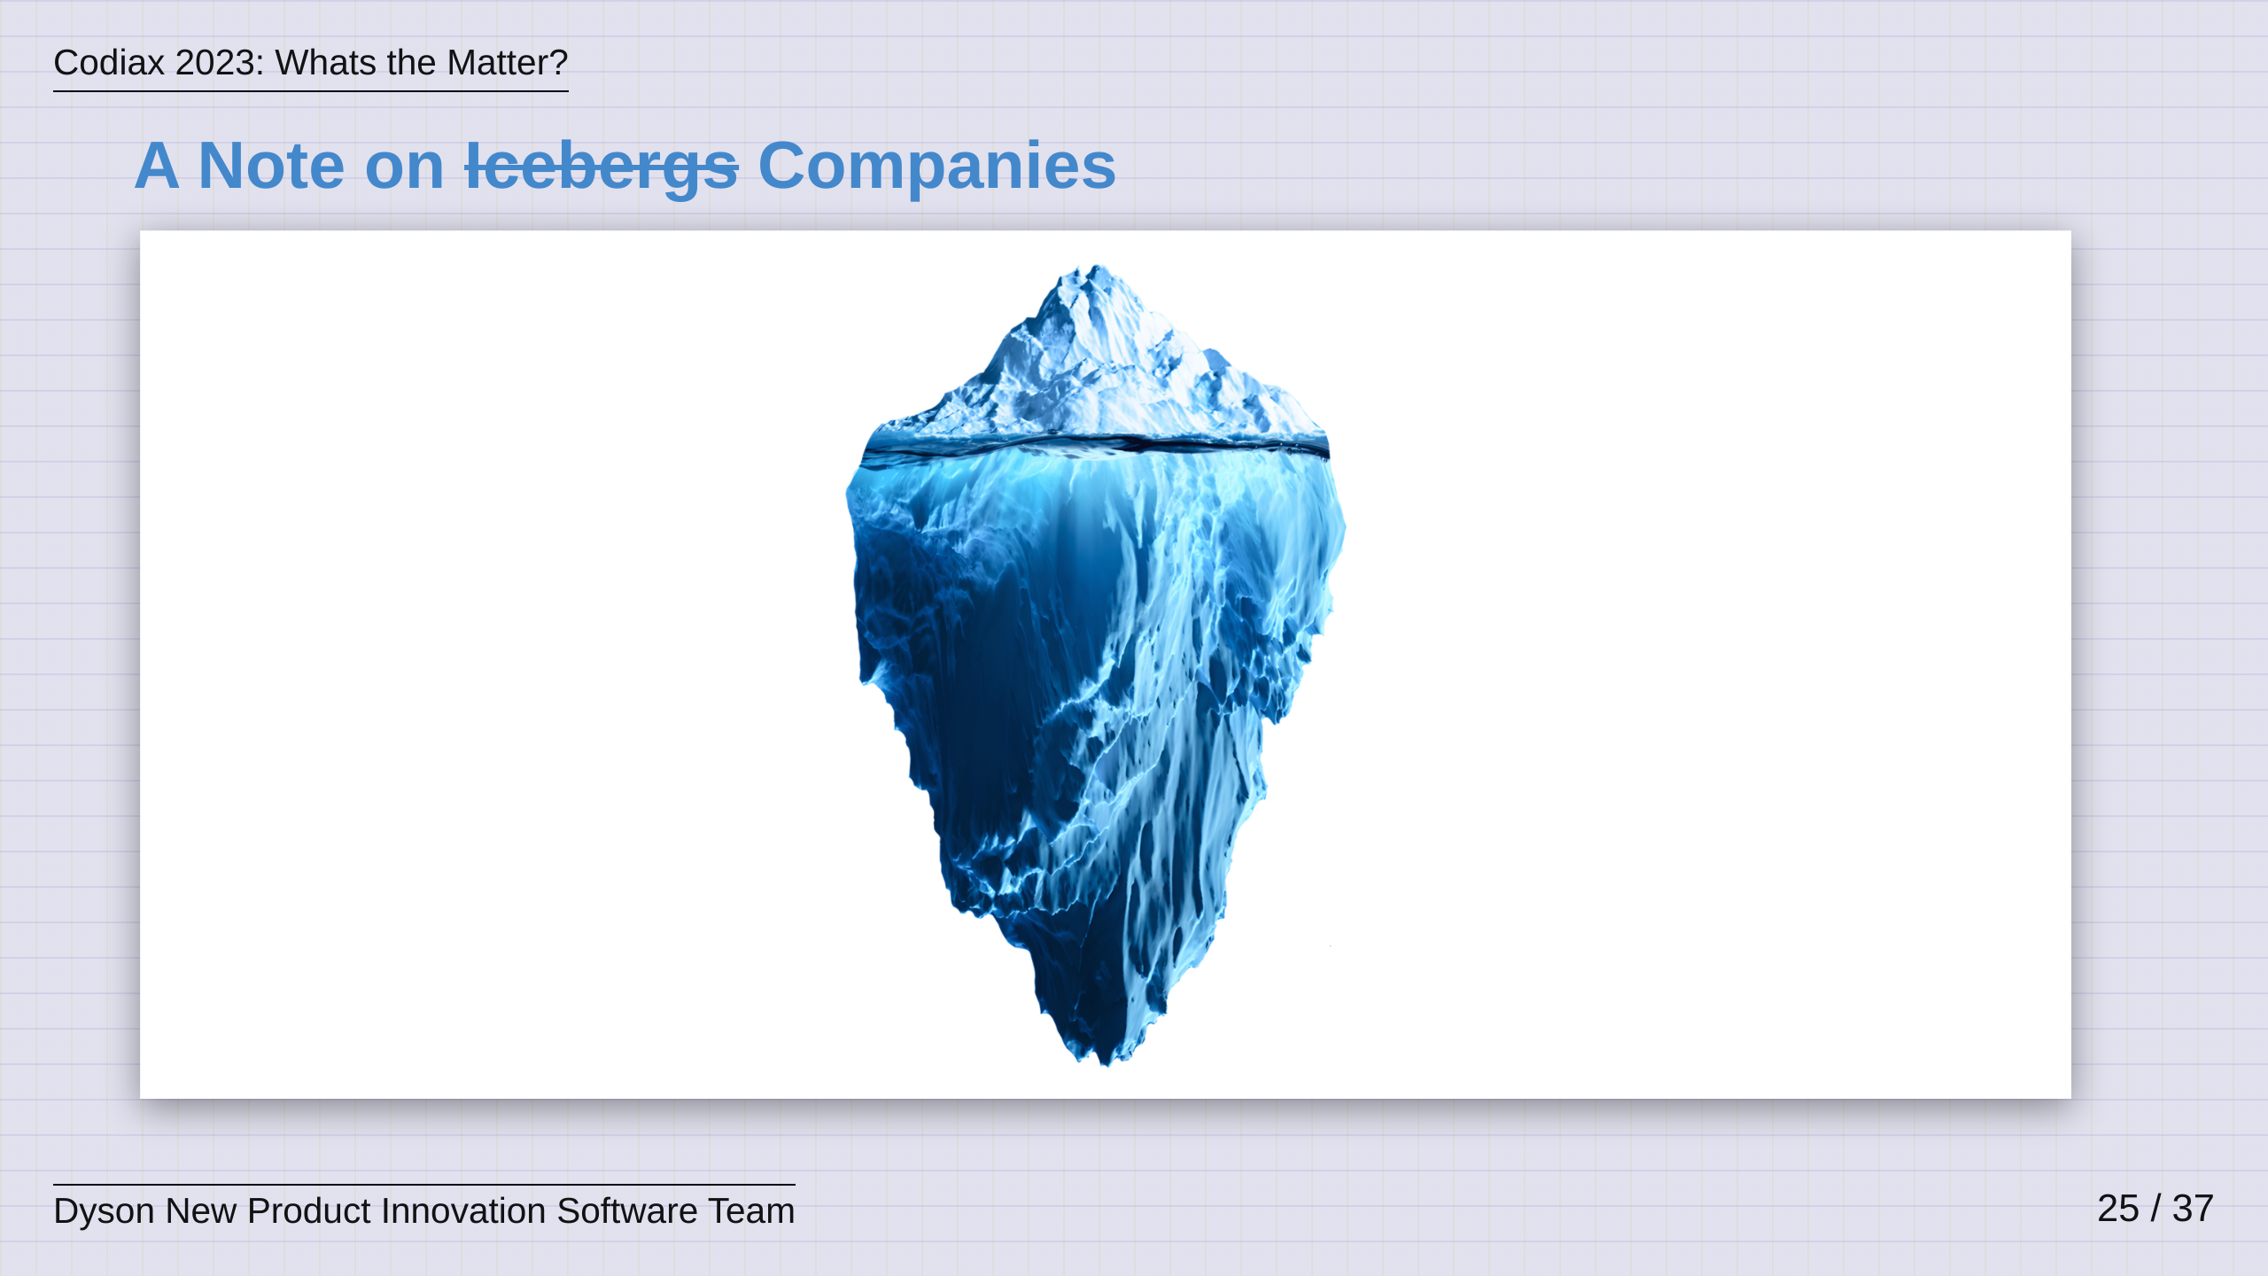
Notes:
Look, I'm sorry to all you climate enthusiasts out there, but I am infact just using the iceberg as a clunky metaphor to keep your attention and begin to talk to you about the difficulties of working on these open and collaborative standards and trying to bring them into real world products at large companies. So, if you'll indulge me for just a second, big companies are sort of like icebergs...

Slide 26
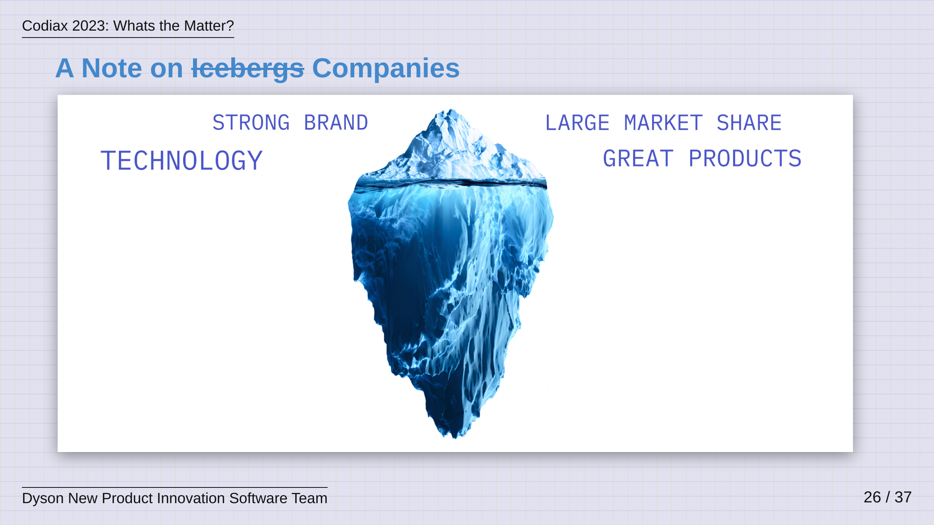
Notes:
In many ways, big companies are majestic and offer a lot for you to see and experience. They have strong brands and influence the market with the great products they release. They are technology driven and its visbale in what they ship. They maybe have a large market share and you may even own several of their products and be a fan.

Slide 27
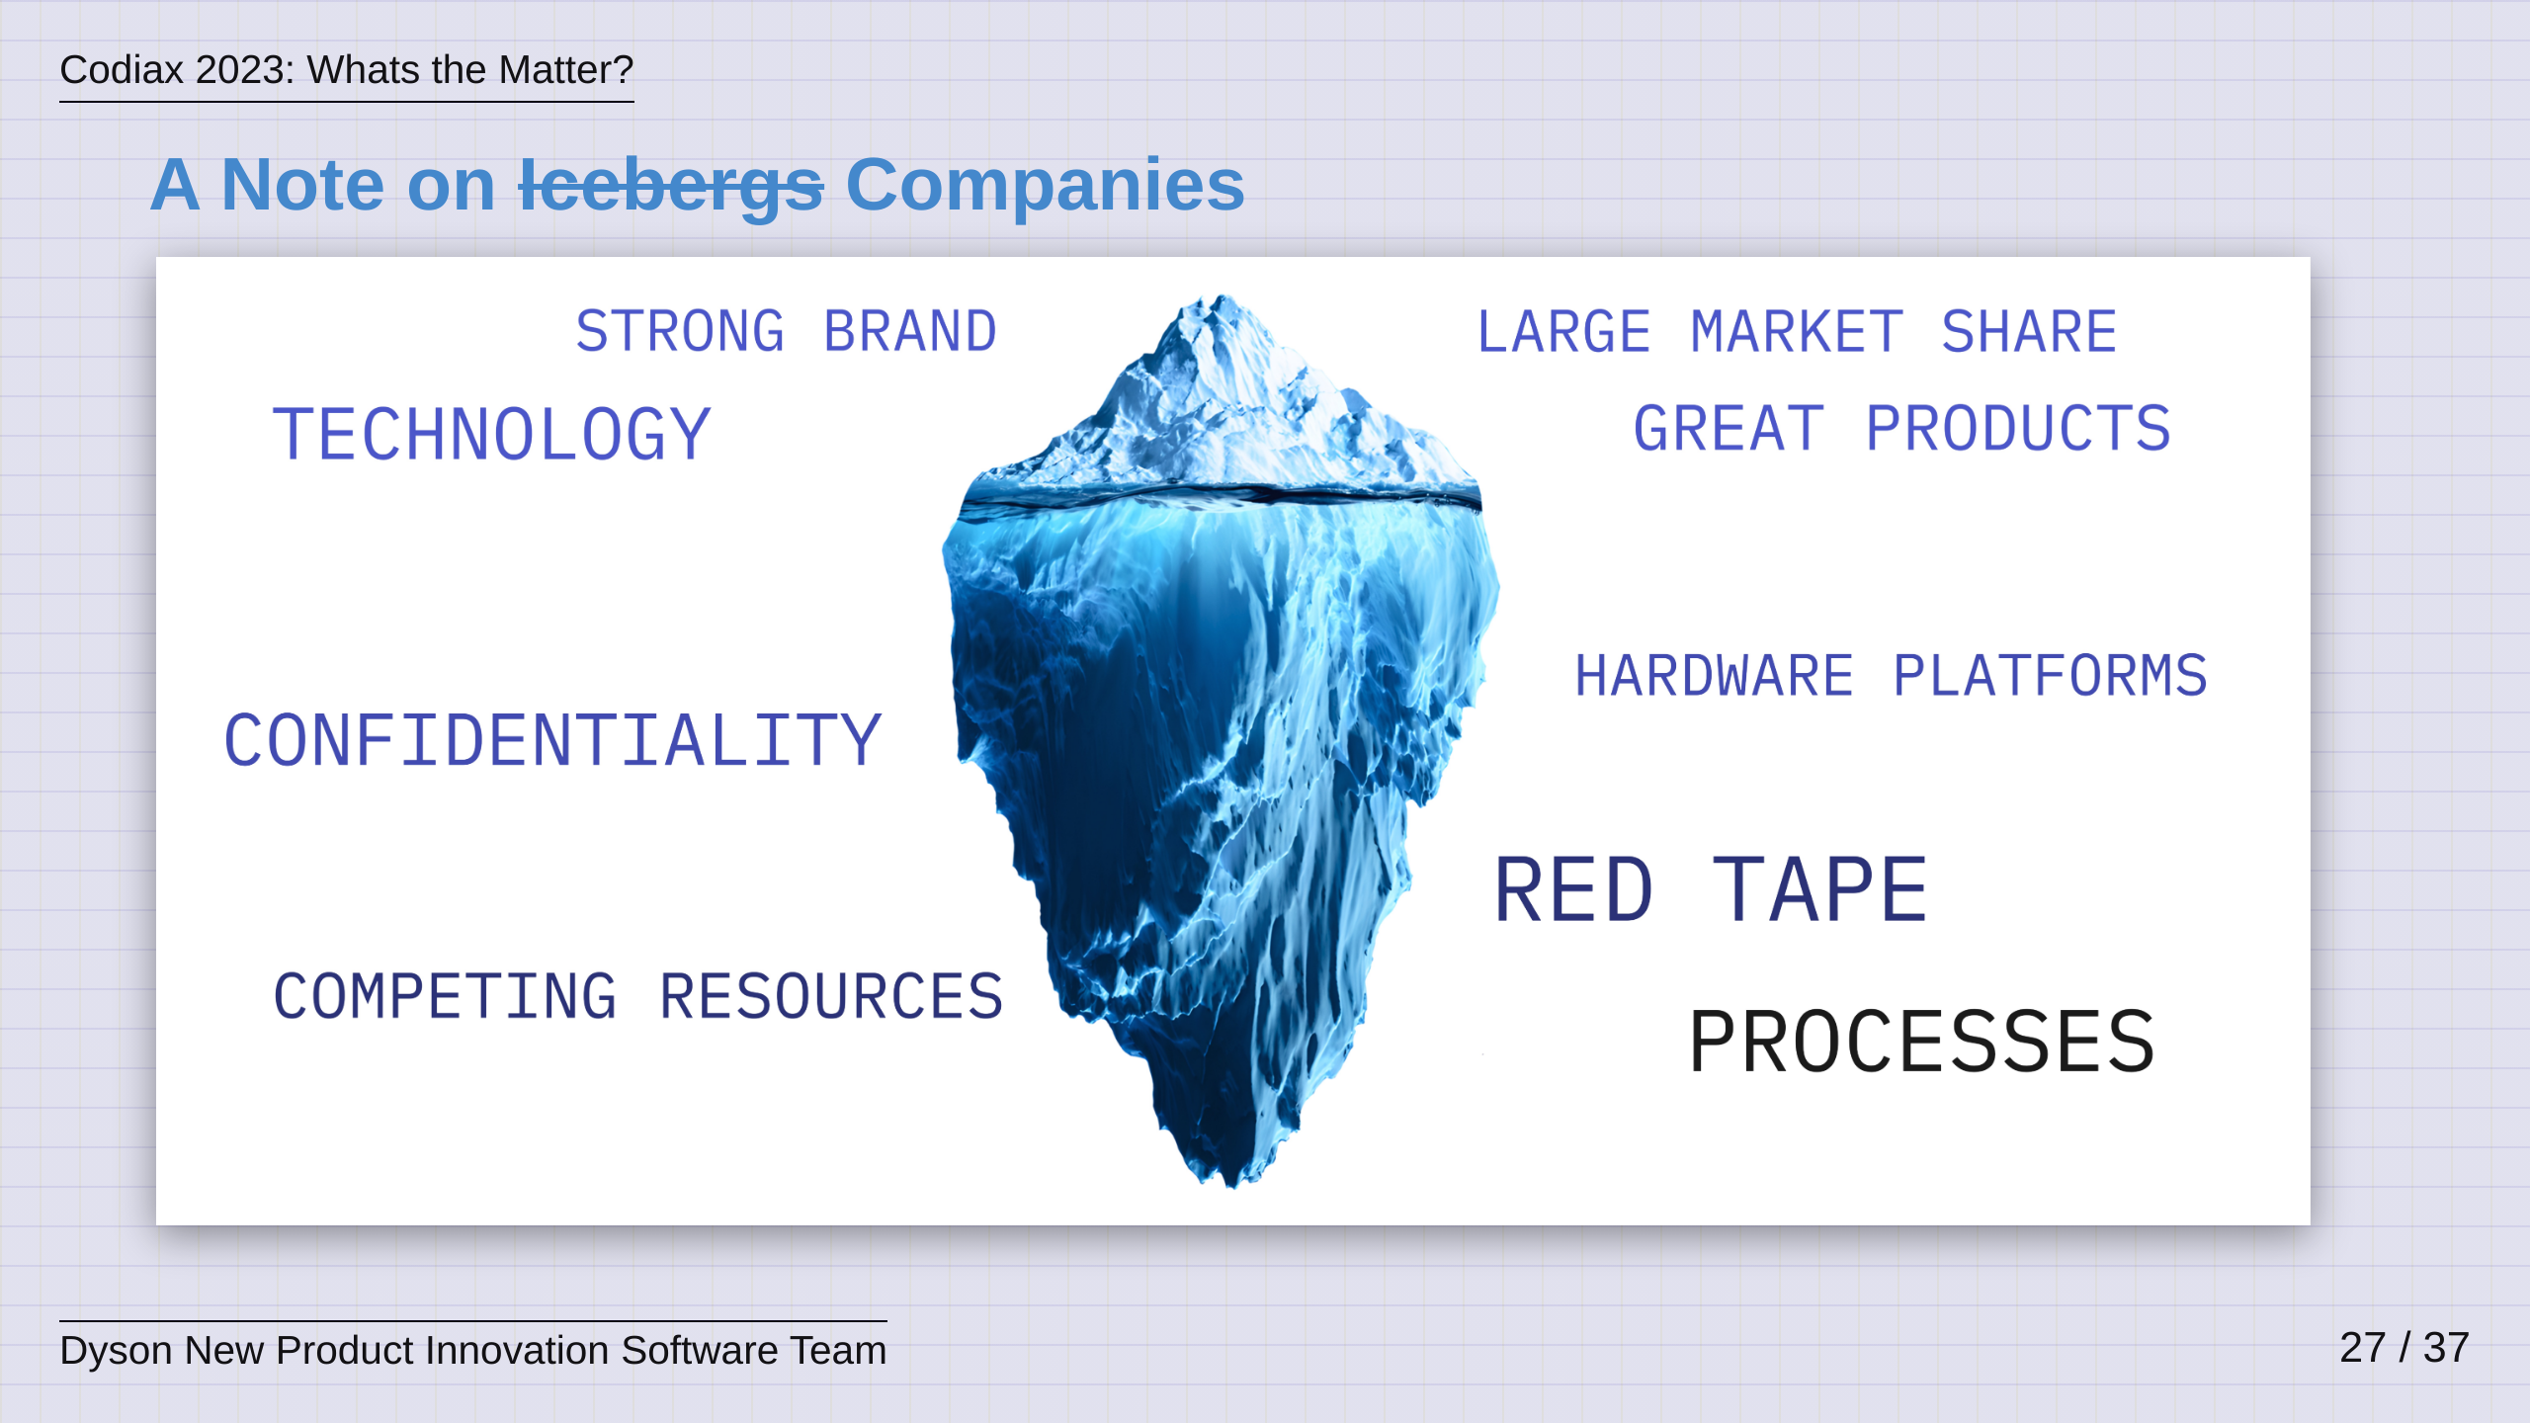
Notes:
But, like the iceberg, there are things that you cannot see. Big companies are steeped in confidentiality, ensuring that they keep their secrets secret. They are tied to internal hardware platforms that vary in functionality and are often driven by cost rather than features. Companies are filled with competing priorities, and this could be prioroties on things like resource management, innovation strategies and commercial roadmaps. Processes also dominate and dictate how big companies should operate, and asking for forgiveness rather than permission will only get you so far. The point I am trying to make here is that none of these things are necessarily bad, they are just reality. I'm trying to point out that when you want to make real change, its important to consider these things up front and learn to make them part of you goal. When trying to not only bring Matter to life, but to then push it into a product, we learned very quickly that that cloning the SDK, understanding it, and running it on our hardware was only one small part of the endeavour we faced. Bringing an entirely new technology and culture into a company and getting it onto a shippable product was not going to be a simple task Change is never easy.

Slide 28
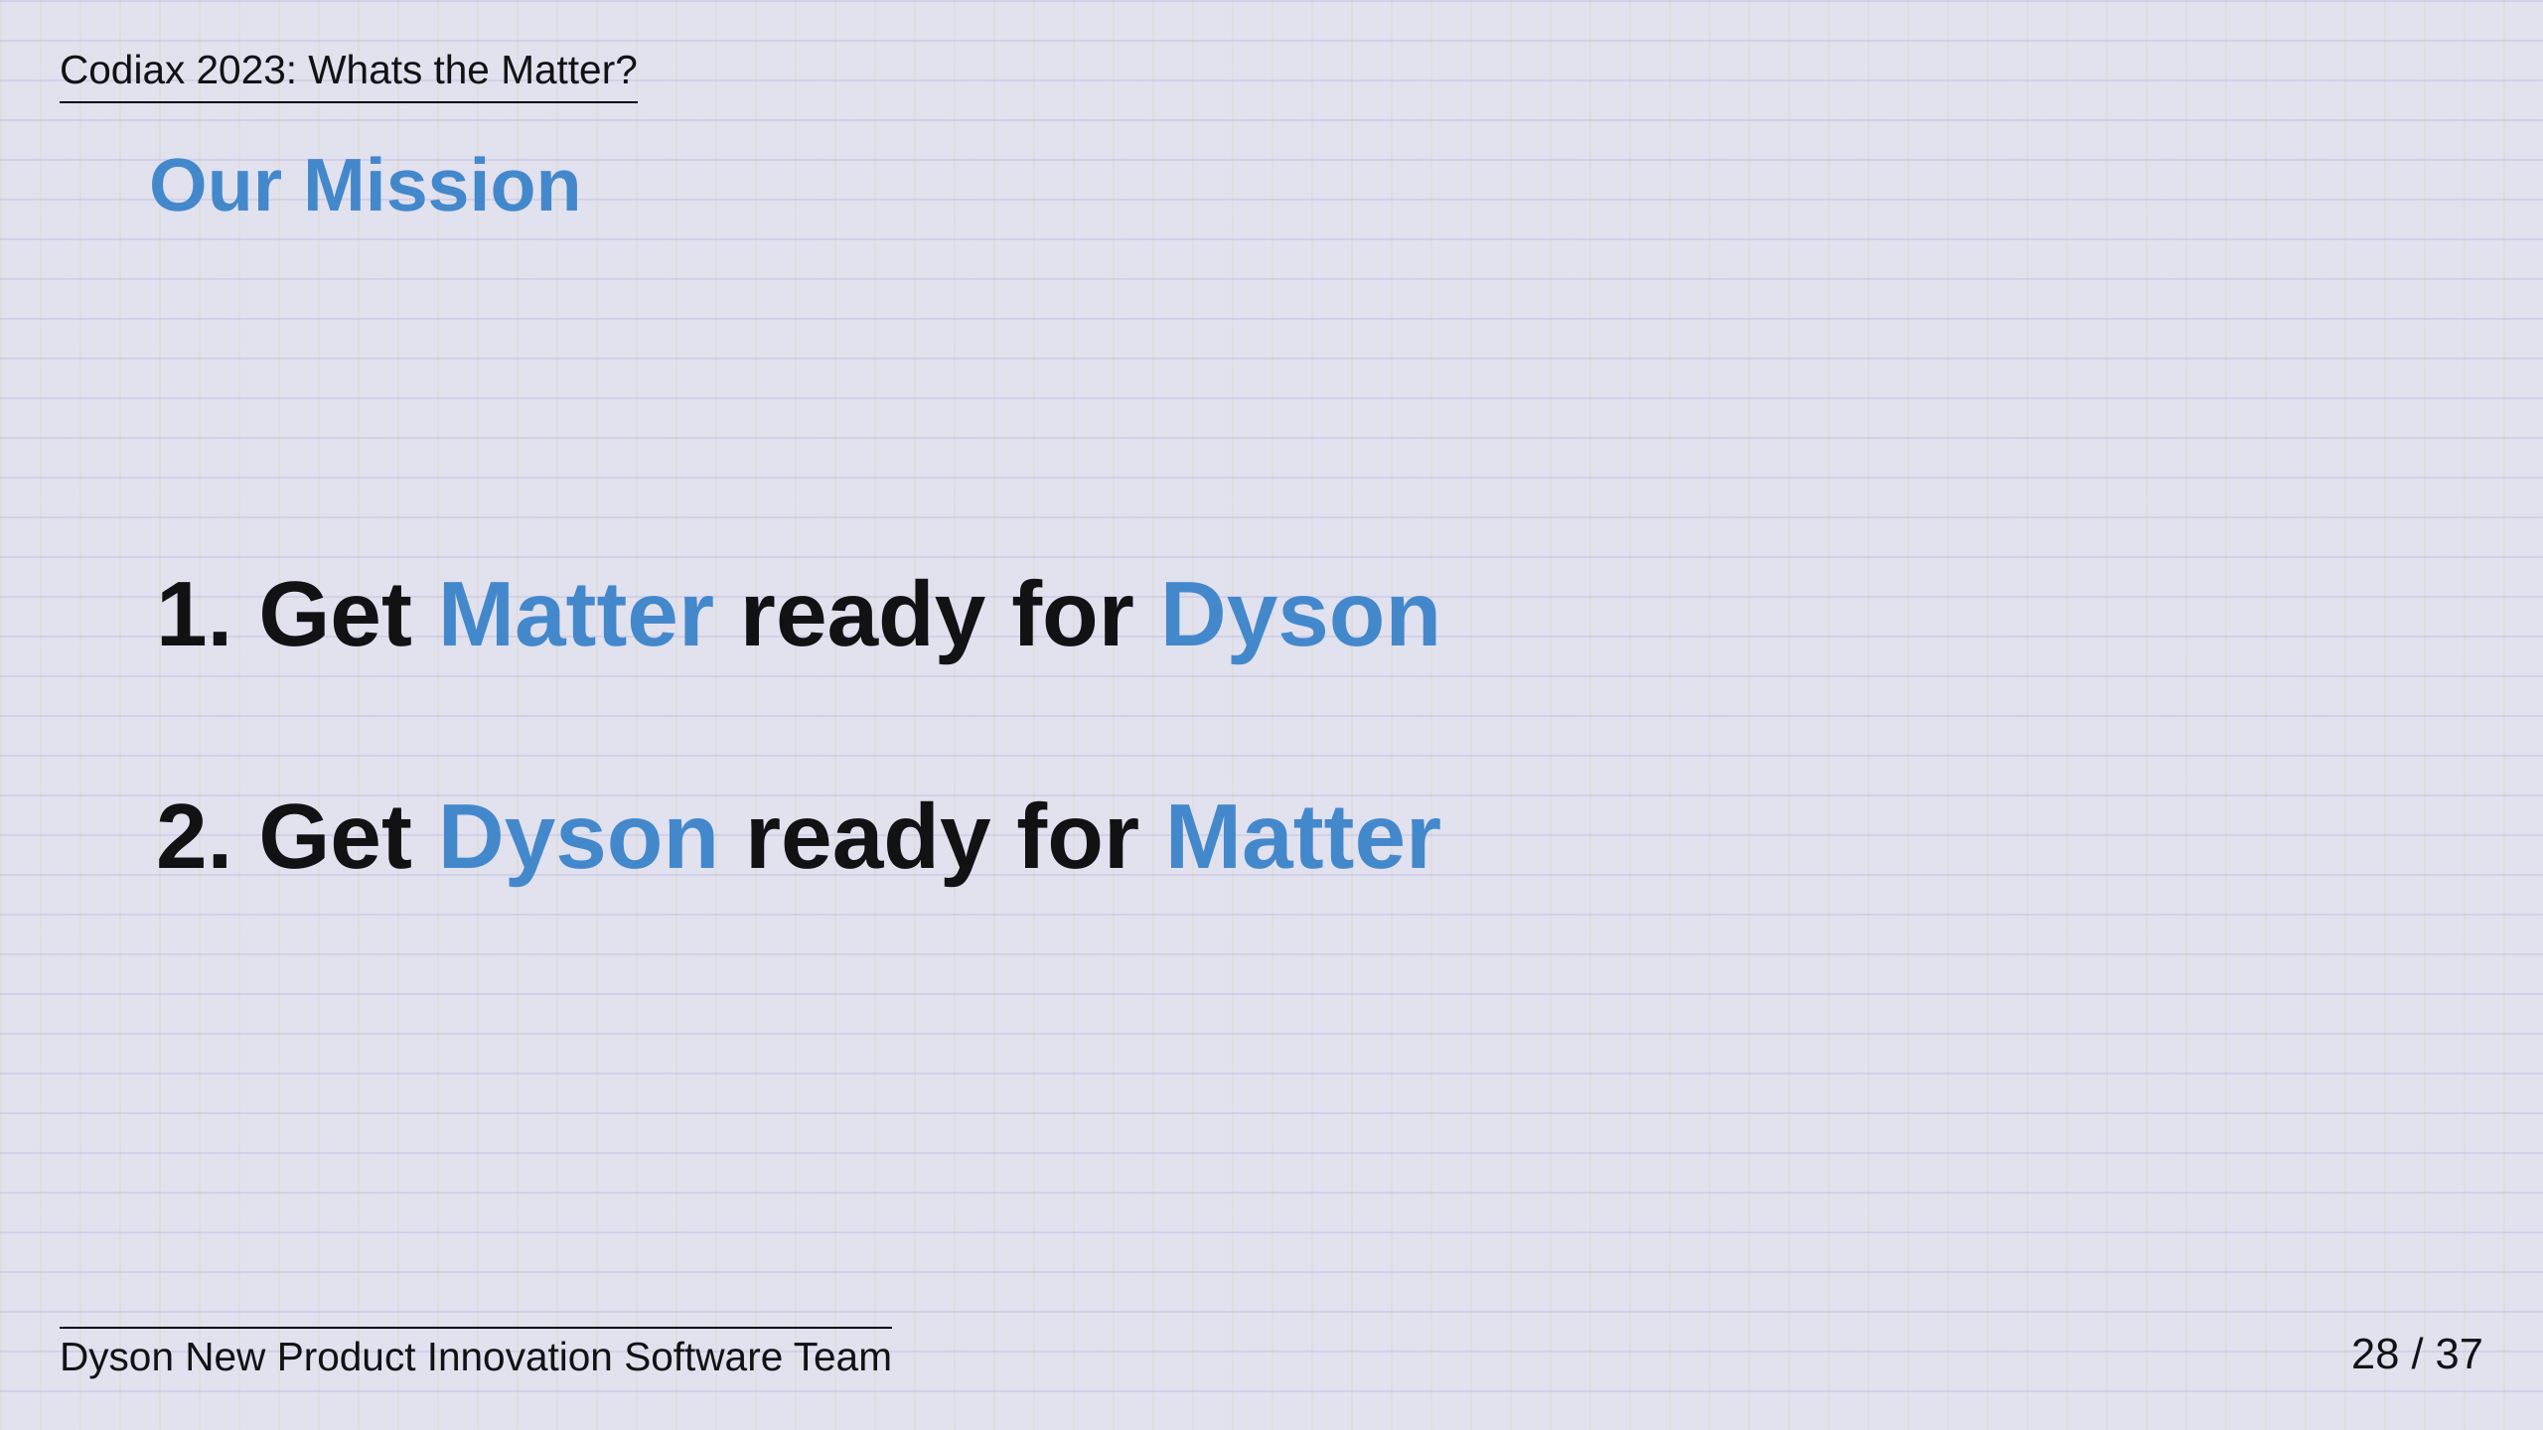
Notes:
This was the mission we set ourselves about a year ago, and it was two pronged, Get Matter ready for Dyson, and get Dyson ready for Matter. Doing these things at the same time was never going to be a simple thing to manage, and I thought it might be interesting to talk through some of this today.

Slide 29
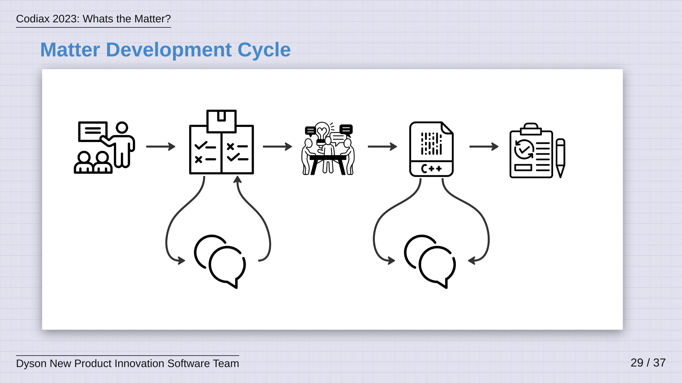
Notes:
The first thing we were met with was the Matter development cycle. This was quite an intense process. The first step was to record all of the reasons why we wanted to add new devices in the form of end user cases and to go and find some other companies that wanted to do the same. Matter typically has a rule of three meaning that you work with at least two other companies to ensure the use cases are generic and meaningful across the market for that device type. These companies then get together, form a team, present this work at a Matter Members' Meeting and then it goes to a vote with the steering committee. We did this in Amsterdam in late 2022. Following this, we entered into the first unknown - updating the Matter spec. Now, this was actually a really interesting exercise and as boring as it sounds I would really encourage you all to try working on a spec sometime with a distributed group of developers. You are forced to think about language and the nuances of statements so much more than usualy so as to ensure clear interpretation once the spec is released. All spec changes were managed on git, via Pull Requests, with comments coming from every timezone, which was exciting, but still a little stessful when you see github pinging you notifications at 11pm. Still it was interesting to re-wire your brain a little and learn to ignore these things until working hours. After the spec is updated and has gone through a ballot vote with all the members of the CSA, then the real work starts - we had to work out how to update the code. If I am honest, this was a mindfield and a steep learning curve that required many meetings and many pair programming sessions amongst our little team. Matter is a dense C++ codebase with a lot of esoteric configuration files - its essentially like any massive, yet young, software project, its still in very active development! We had to adopt the age old strategy of asking as many questions as we could to as many friendly people that we could find in order to work things out and gradually make progress. I will admit, it was a daunting task at times but it was a great lesson in teaching me that things generally work out ok with some focus and time. It definitely did wonders for any lingering imposter syndrome! Like the spec, this was a Pull Request driven SDK with a gruelling CI pipeline, it took some time but we generally worked things out slowly and managed to put in a significant number of changes.

Slide 30
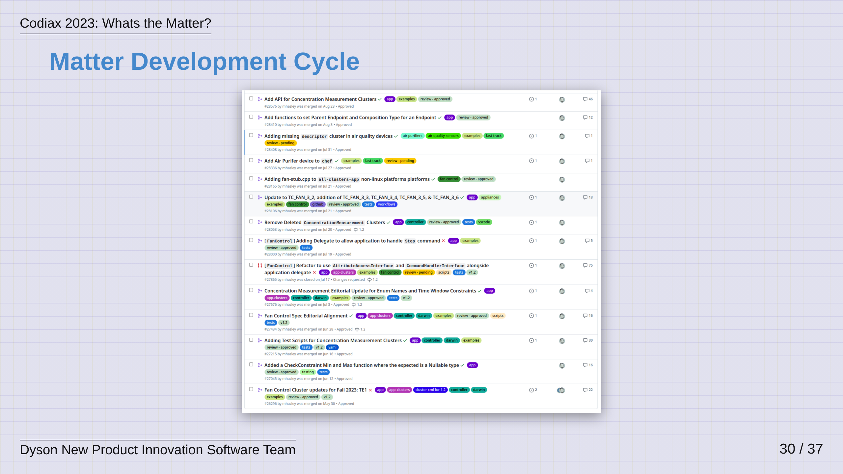
Notes:
I've screenshotted my PRs on the SDK just to show you the level of input a contributor can have here - I guess I also wanted to show that I did some work! But genuinely, this is a member driven standard. The big takeaway for us was that the SDK was a daunting place for new developers, and we flagged this repeatedly to the governing body, the CSA. The response we got was exactly the right one, "What are you going to do about it?" - I'll say it again.... member, driven, standard. So, we did just that and our little team paired with some brilliant Google engineers to deliver the first intro session for new SDK developers at the last Members Meeting which we paired with the beginnings of new documentation on this topic. I would say this is one thing to realise about working on these open source projects; I think its important to realise that you have a duty to contribute more than just the things you need.

Slide 31
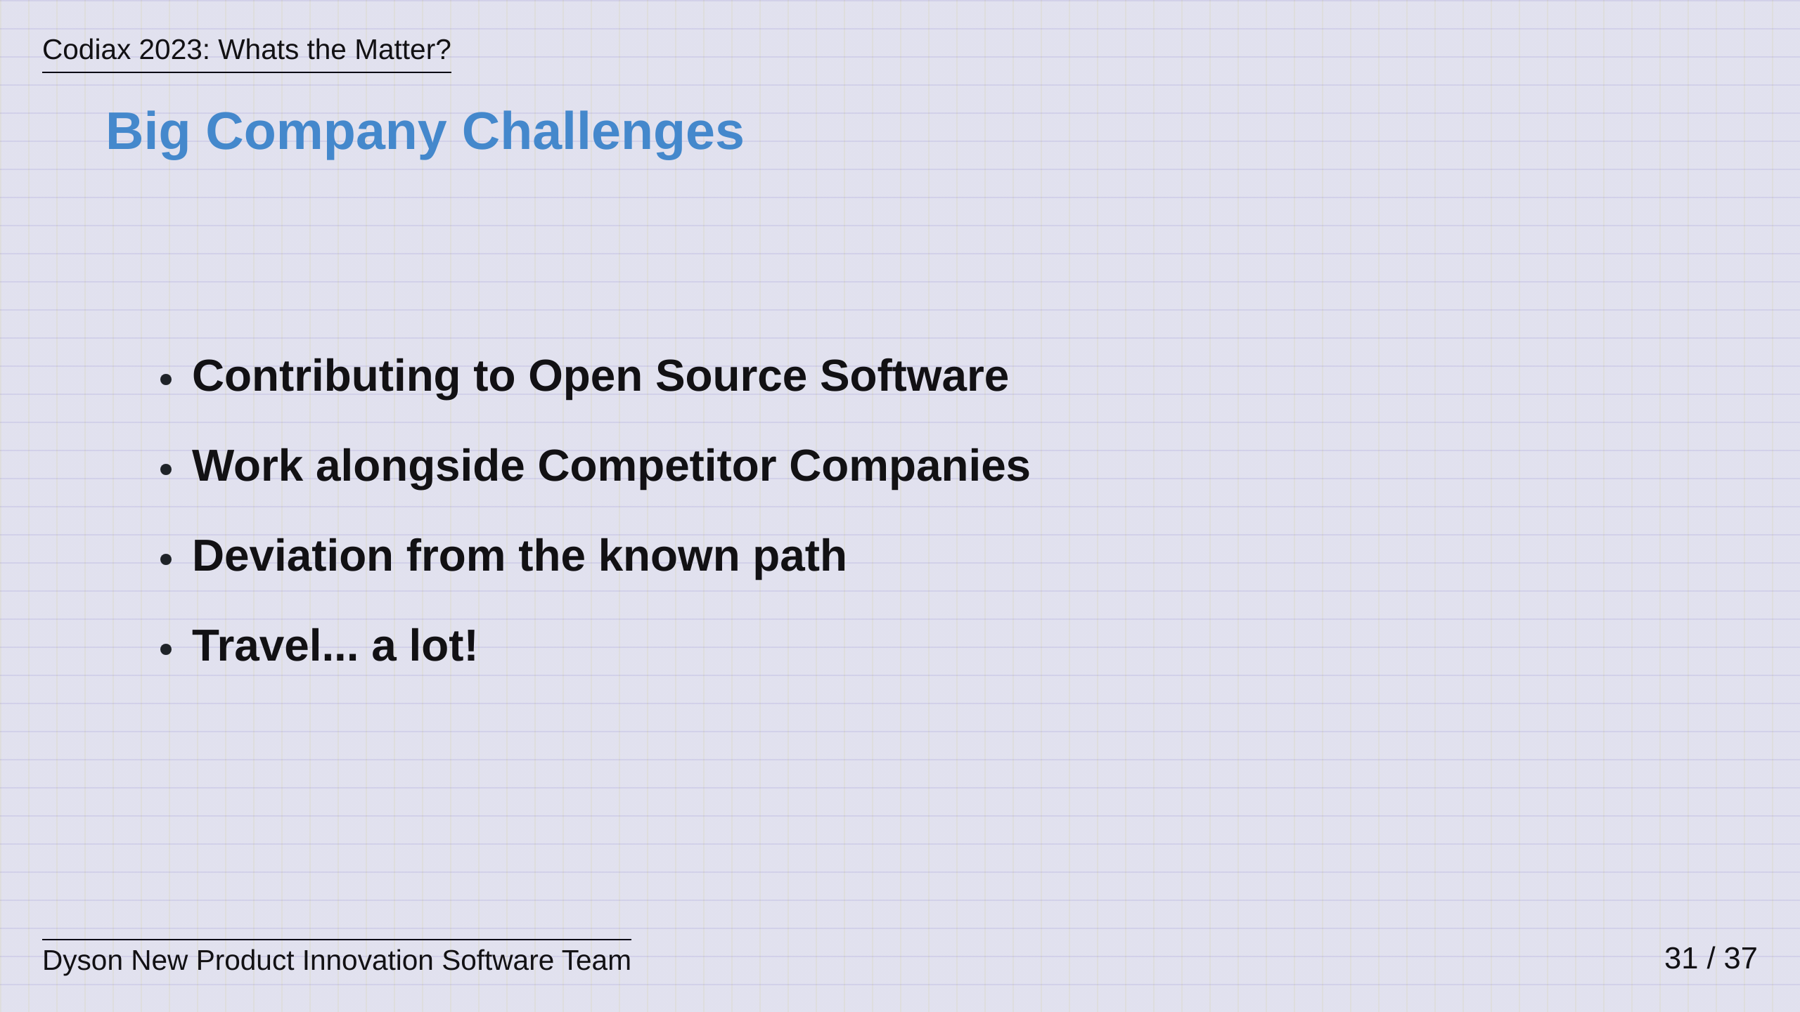
Notes:
So, while all the Matter development was happening, we had to deal with the second part of our Mission - making Dyson ready for Matter! This meant ensuring it was ok for us to work on Open Source Software, which was interesting, considering our contracts said that we couldn't! We also had to work closely with our own competitors in the market, meeting often to share workloads and work through problems together - this definitely raised a few eyebrows with our managers! We had to take Dyson away from its known and comfortable path - when we started, we had support for Google Home and Amazon Alexa and it was working well, people were wondering why we wanted to break that. And yeah, we had to travel a lot. Attendance at the Members Meetings is really important to ensure your voice is heard and then on top of that, there are in-person test and verification events for the new device types - lets say the finance department might have me on a list at this point! Anyway, lets drill into these a little bit...

Slide 32
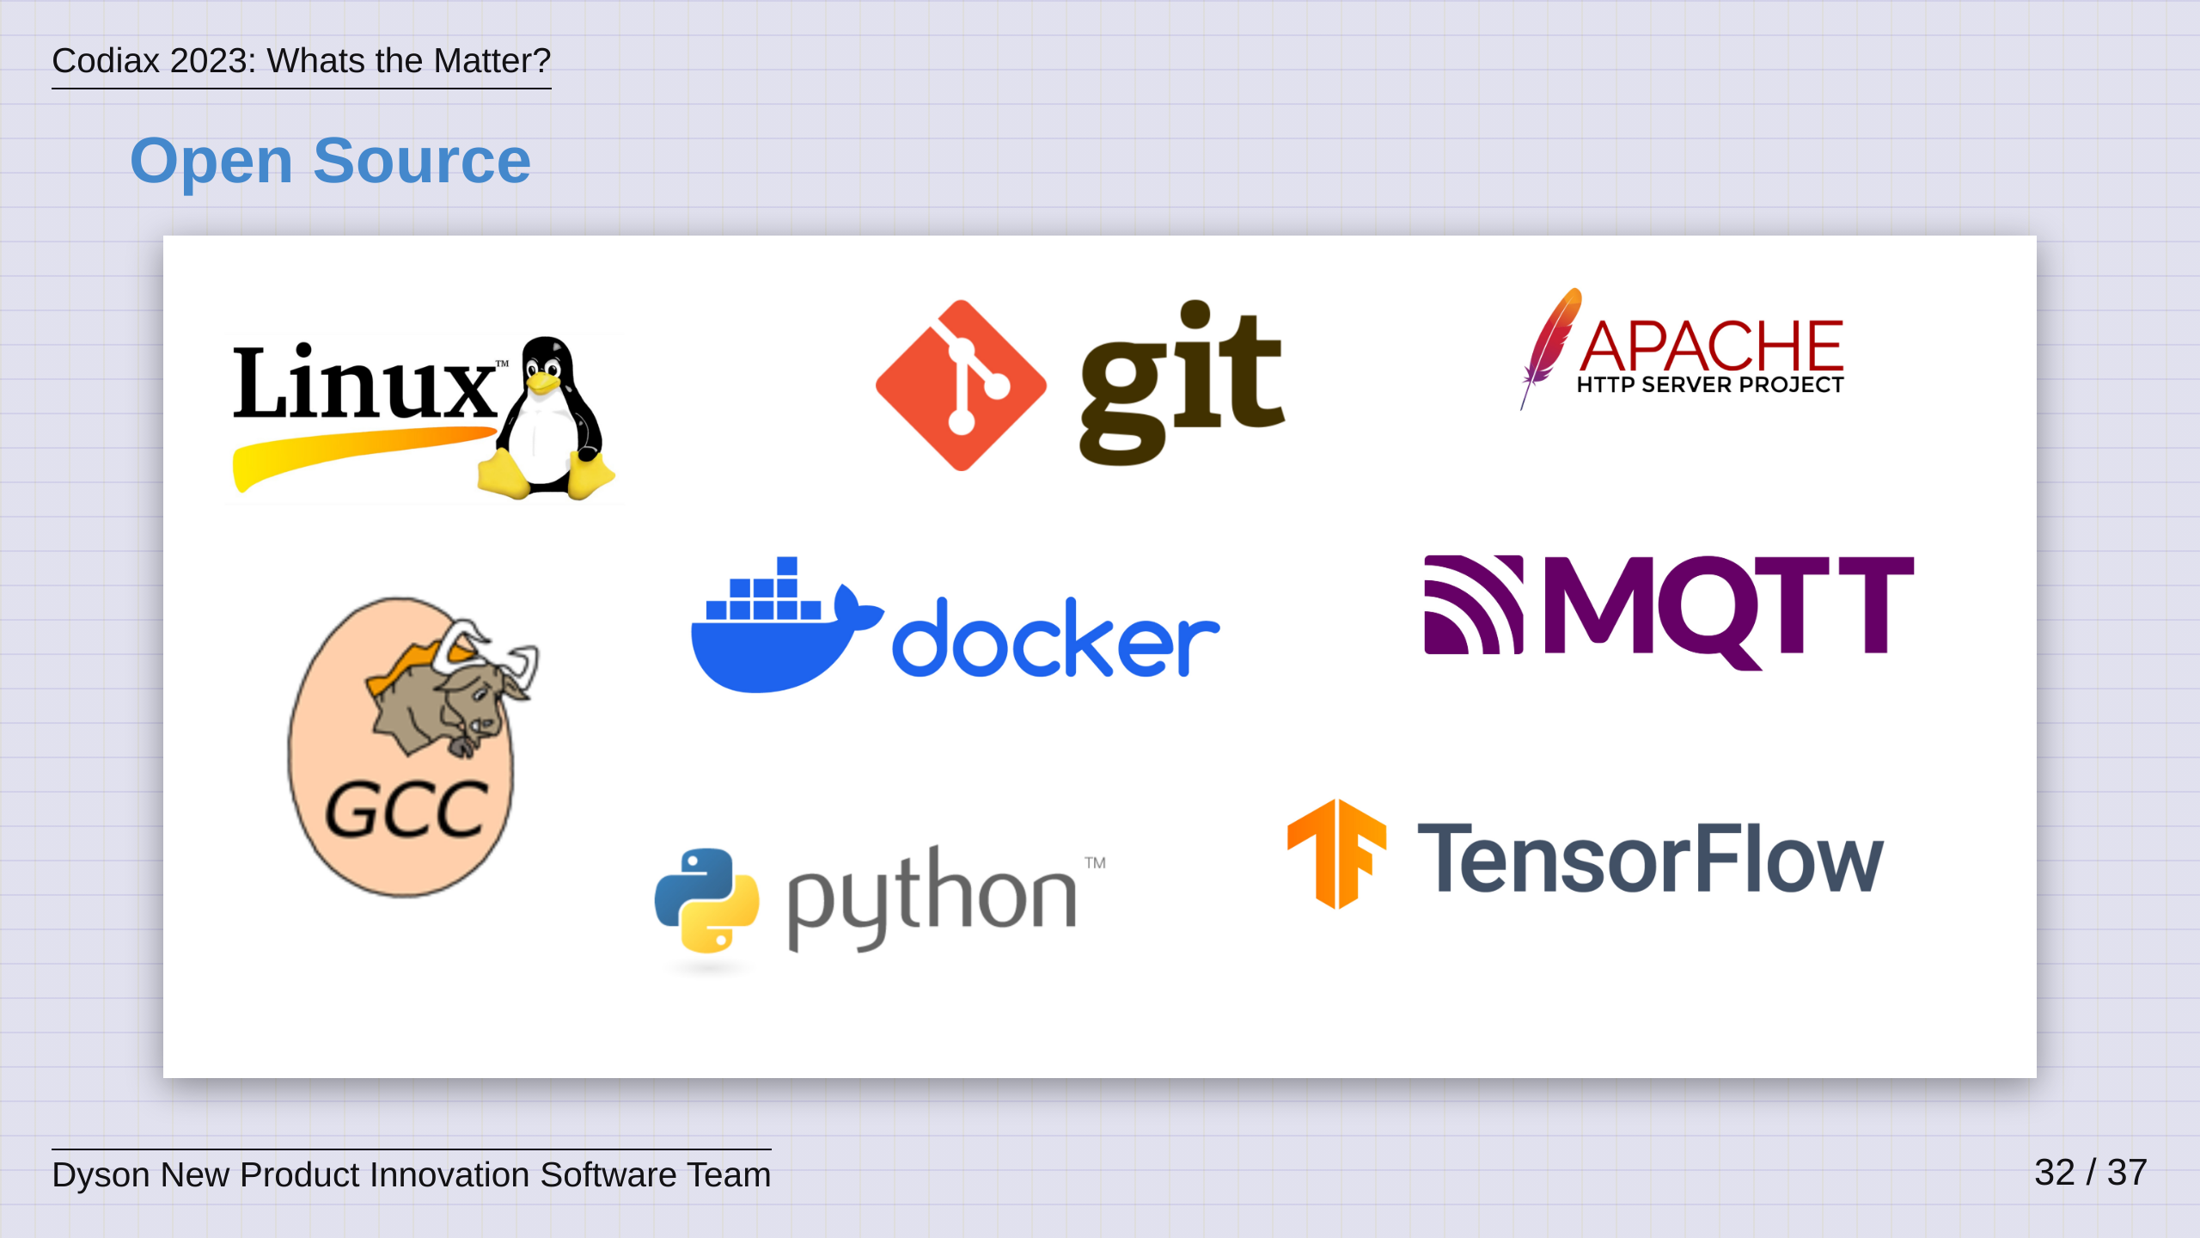
Notes:
Th world is built on open source Open source software stands as a cornerstone of collaborative innovation, fostering a global community where individuals come together to create, refine, and freely share solutions. This democratic approach to software development not only accelerates technological advancements but also empowers users with the freedom to understand, modify, and distribute software. The transparent nature of open source projects encourages diverse perspectives and collective problem-solving, leading to robust, secure, and high-quality software. Open source software is at the foundations of a lot of proprietary code and as such, I think its important for companies to engage and contribute back. This will lead to: Skill Enhancement, Professional Development, Community Engagement, Innovation and Problem Solving, Code Quality, Visibility and Recruitment. Companies can also be quite savvy here as being at the forefront of these developments allows them to shape the narrative and that was definitely the case with Matter! Important to be OPEN about open source - Set out guidelines around the Approvals Process, a Code of Conduct and consider IP at all points in the process.

Slide 33
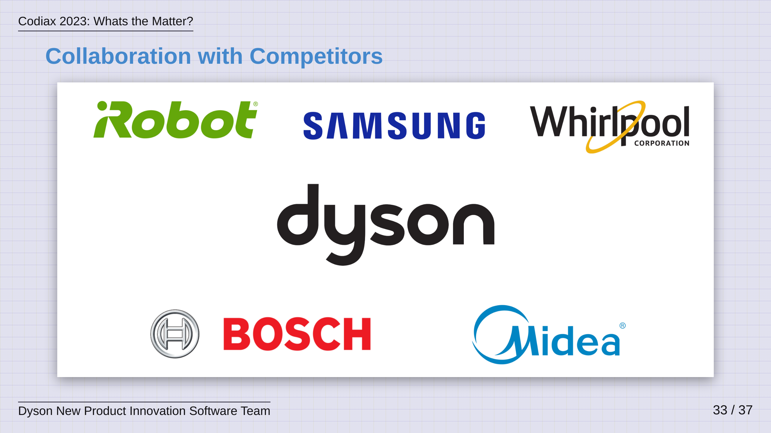

Slide 34
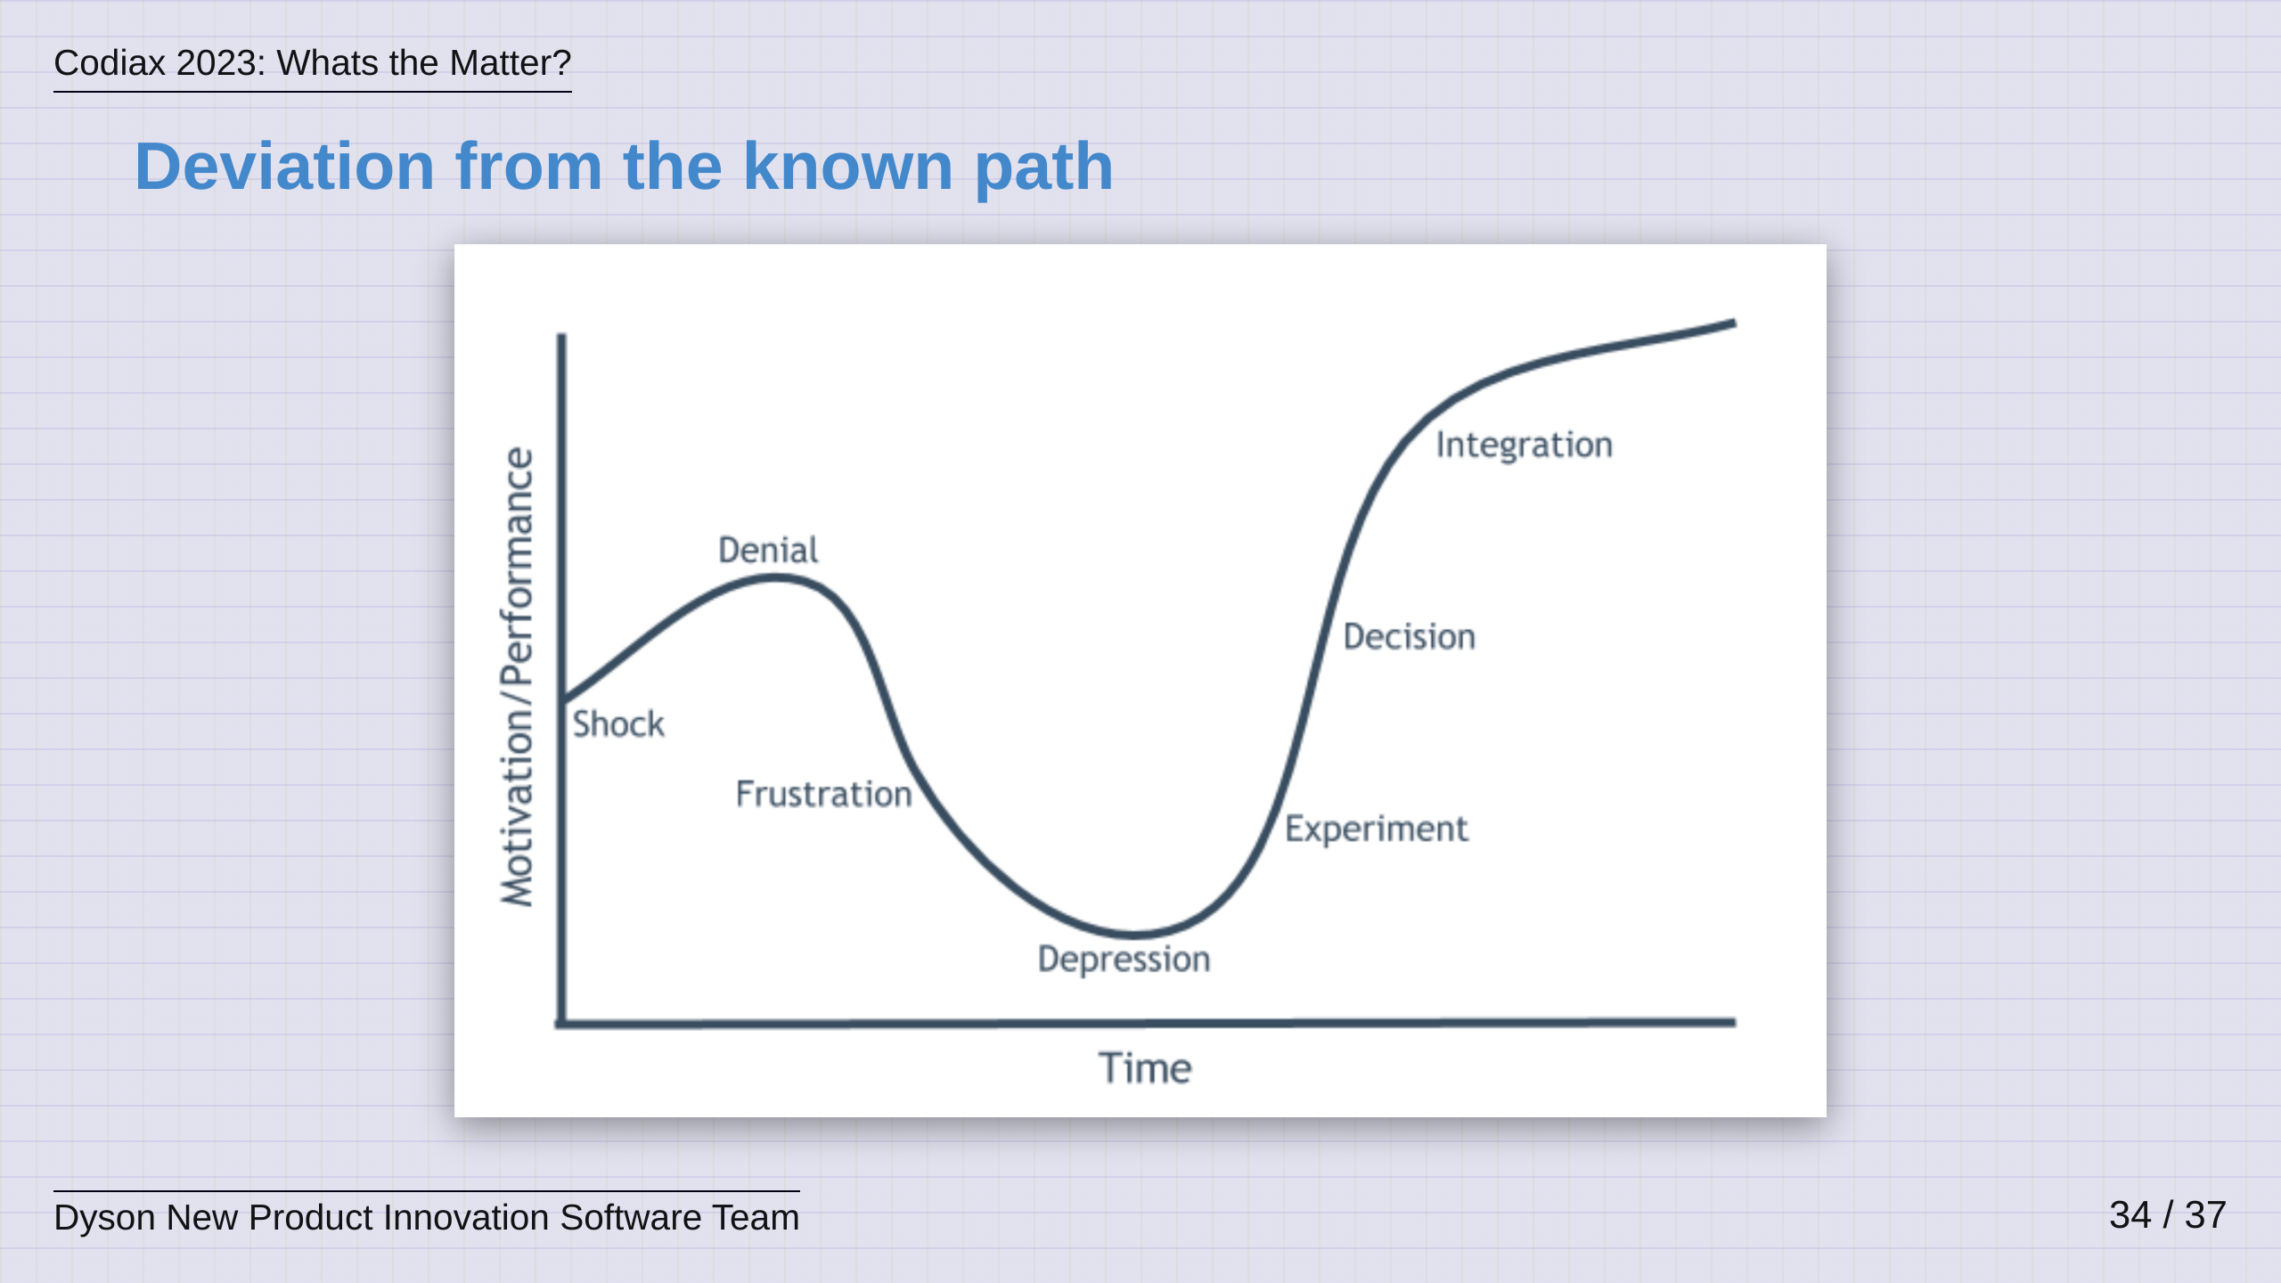

Slide 35
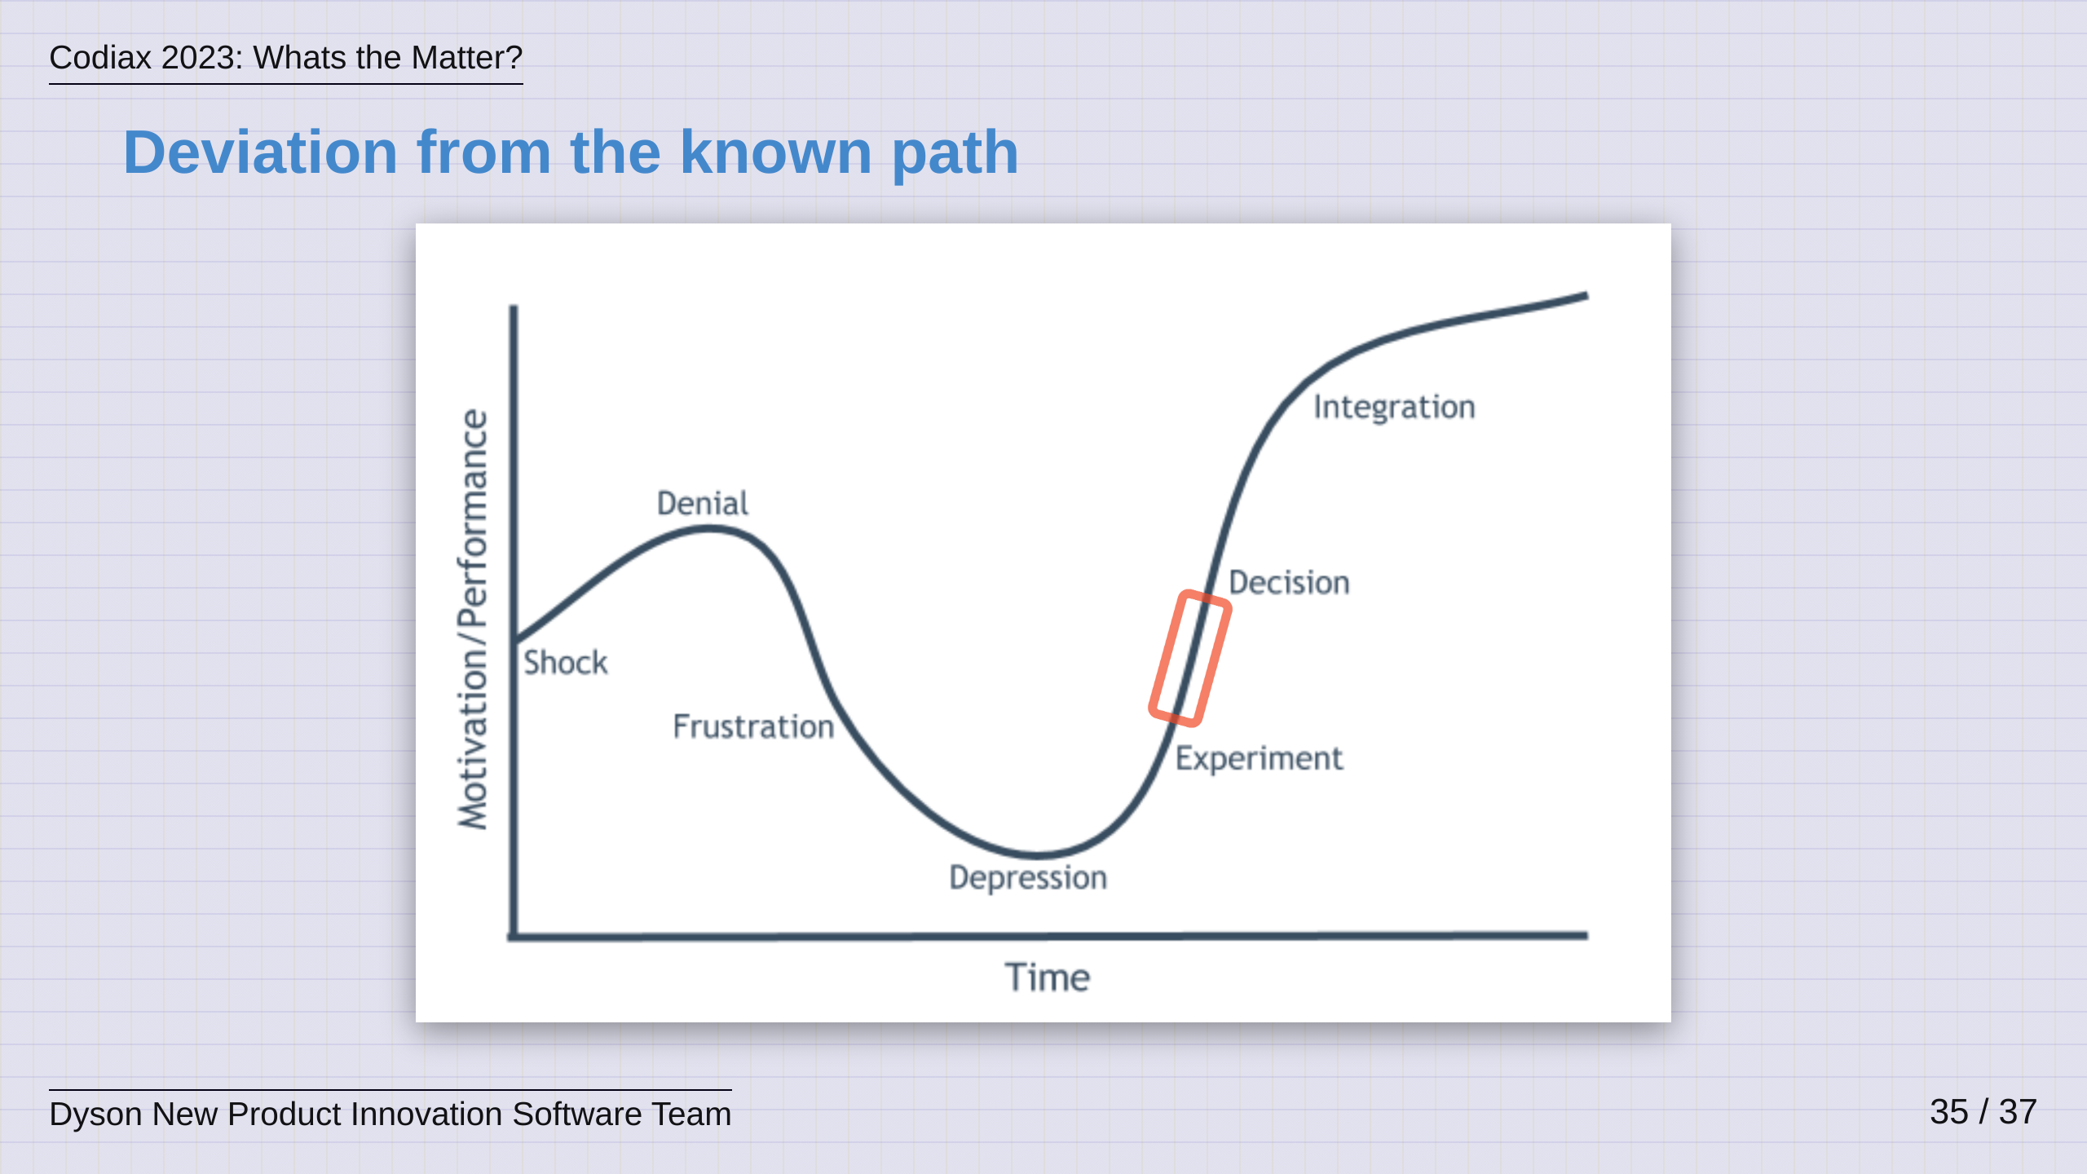

Slide 36
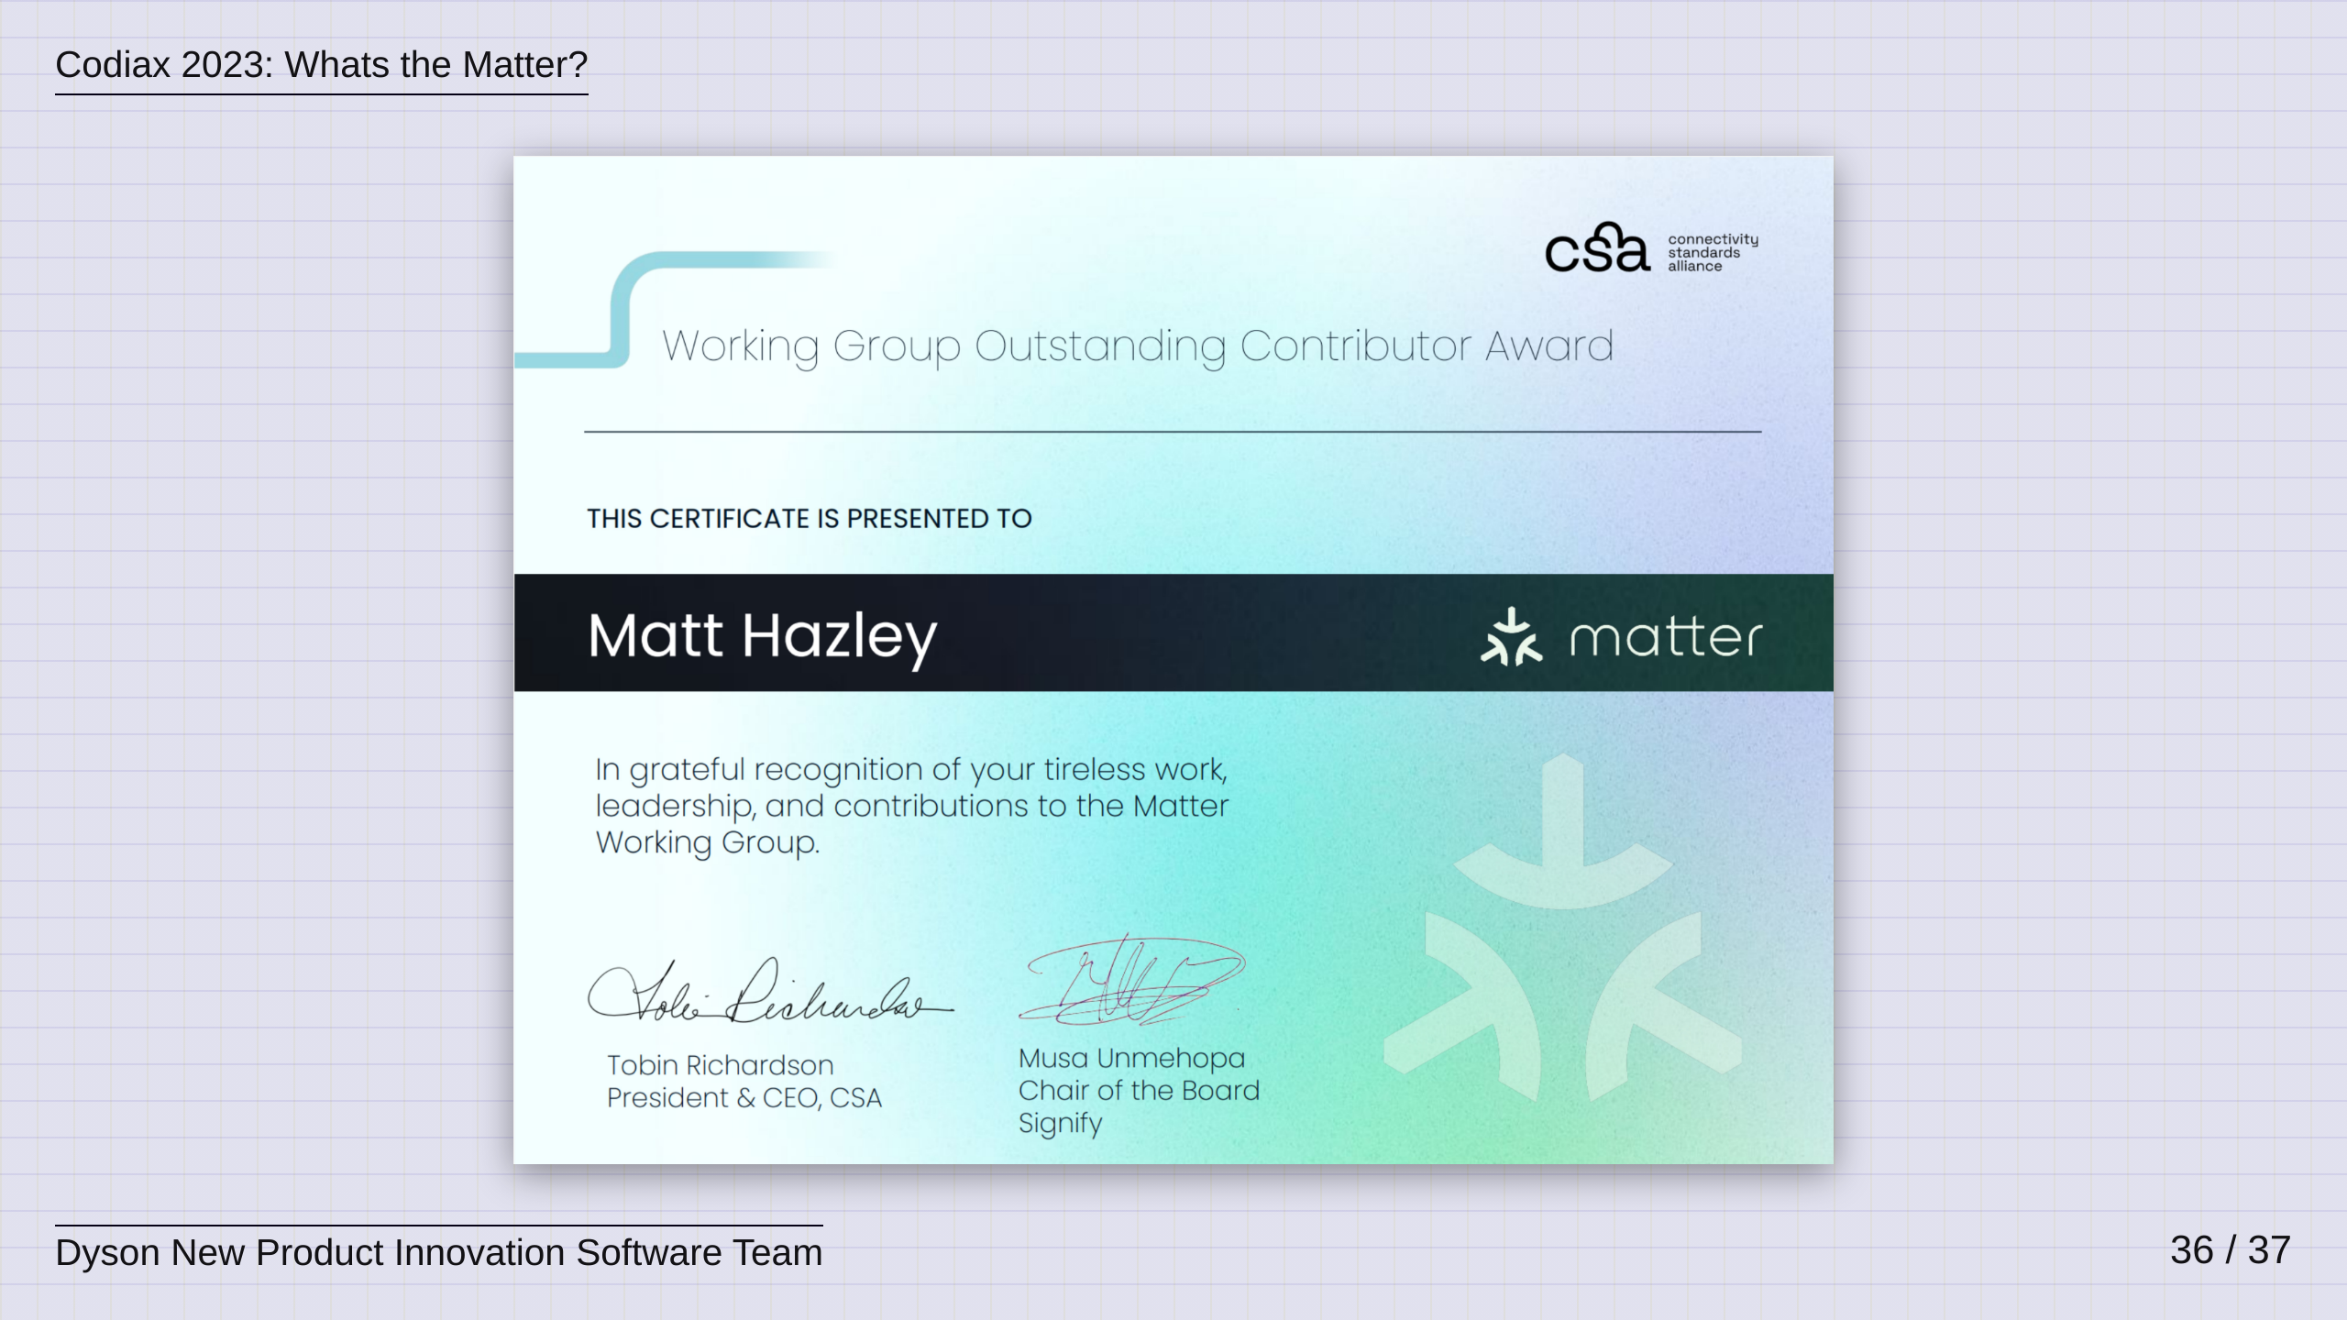

Slide 37
